Slide 1
EPFL Space Center eSpace
Space Propulsion ENG-510

Slide 2
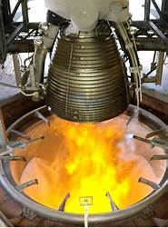
Lecture # 2 Part # 2 Introduction in Propulsion Systems
Brief overview on all space propulsion systems

Slide 3
What is the principle of Space Propulsion?
Basic Working Principle for Propulsion:
In its simplest form, a propulsion system accelerates matter to provide a force of thrust that moves or rotates a vehicle
Example: Small row boat on the lake of Geneva
Basic rocket equation (Tsiolkovsky rocket equation): The basis principle of a classical rocket engine is to eject mass with a high velocity. The recoil of this ejection is then increasing the velocity of the Spacecraft (S/C) including the Payload (P/L) as well as the remaining propellant
L2 – Propulsion Systems
Space Propulsion ENG-510

Slide 4
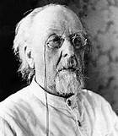
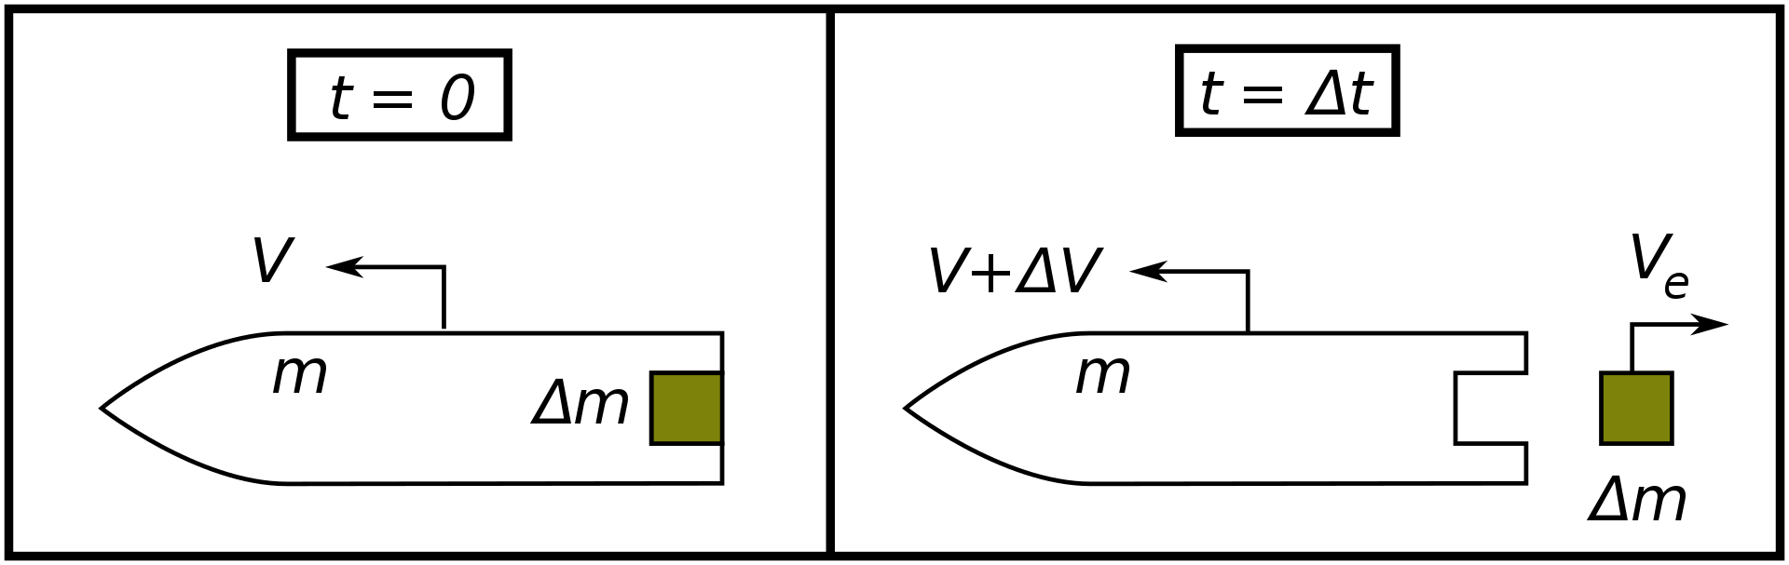

What is the principle of Space Propulsion?
Basic Working Principle for Propulsion:
Basic rocket equation (Tsiolkovsky rocket equation)
$$∆v=v_{e}ln\frac{m_{0}}{m_{1}}$$
L2 – Propulsion Systems
Space Propulsion ENG-510
Konstantin Tsiolkovsky

Slide 5
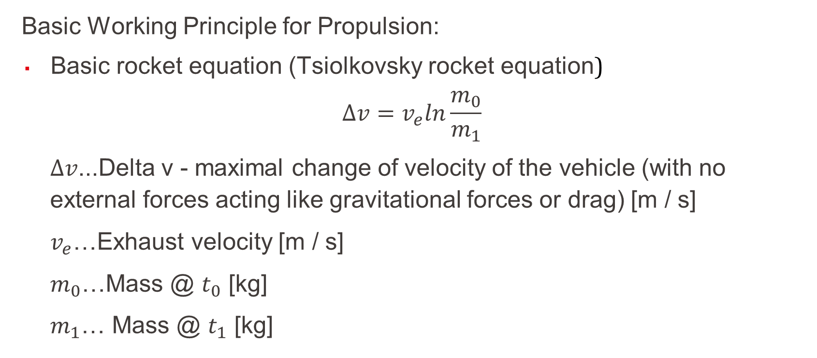
What is the principle of Space Propulsion?
Basic Working Principle for Propulsion:
Basic rocket equation (Tsiolkovsky rocket equation)
$$∆v=v_{e}ln\frac{m_{0}}{m_{1}}$$
$∆v$...Delta v - maximal change of velocity of the vehicle (with no external forces acting like gravitational forces or drag) [m / s]
$v_{e}$…Exhaust velocity [m / s]
$m_{0}$…Mass @ $t_{0}$ [kg]
$m_{1}$… Mass @ $t_{1}$ [kg]
L2 – Propulsion Systems
Space Propulsion ENG-510

Slide 6
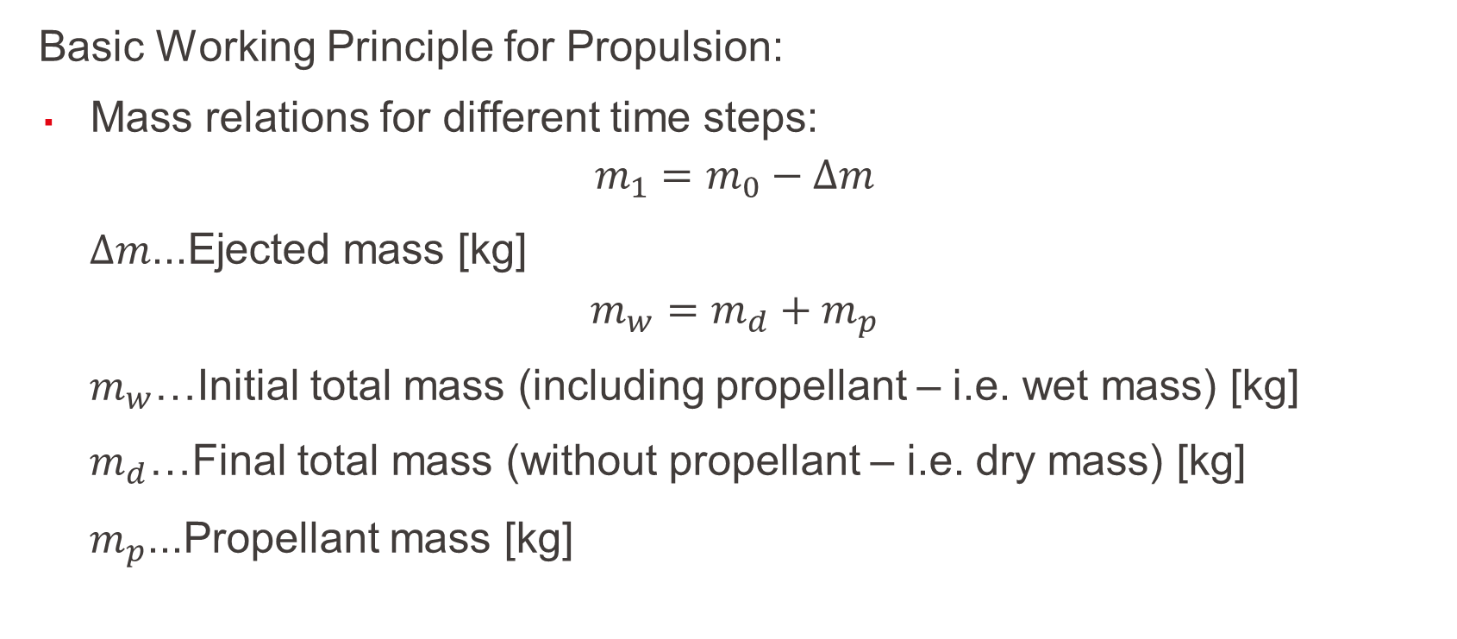
What is the principle of Space Propulsion?
Basic Working Principle for Propulsion:
Mass relations for different time steps:
$$m_{1}=m_{0}−∆m$$
$∆m$...Ejected mass [kg]
$$m_{w}=m_{d}+m_{p}$$
$m_{w}$…Initial total mass (including propellant – i.e. wet mass) [kg]
$m_{d}$…Final total mass (without propellant – i.e. dry mass) [kg]
$m_{p}$...Propellant mass [kg]
L2 – Propulsion Systems
Space Propulsion ENG-510

Slide 7
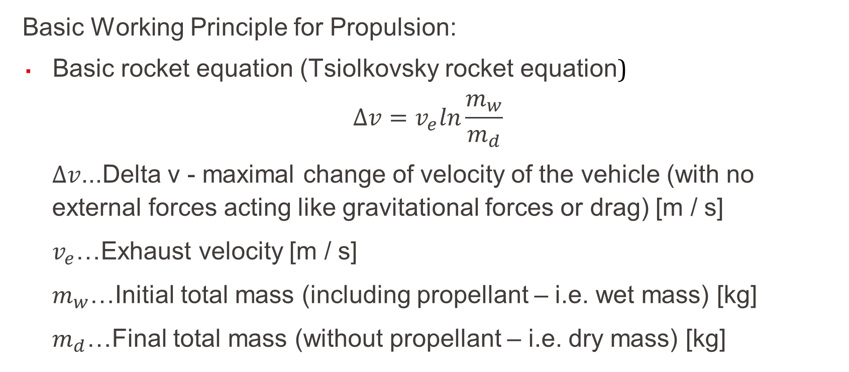
What is the principle of Space Propulsion?
Basic Working Principle for Propulsion:
Basic rocket equation (Tsiolkovsky rocket equation)
$$∆v=v_{e}ln\frac{m_{w}}{m_{d}}$$
$∆v$...Delta v - maximal change of velocity of the vehicle (with no external forces acting like gravitational forces or drag) [m / s]
$v_{e}$…Exhaust velocity [m / s]
$m_{w}$…Initial total mass (including propellant – i.e. wet mass) [kg]
$m_{d}$…Final total mass (without propellant – i.e. dry mass) [kg]
L2 – Propulsion Systems
Space Propulsion ENG-510

Slide 8
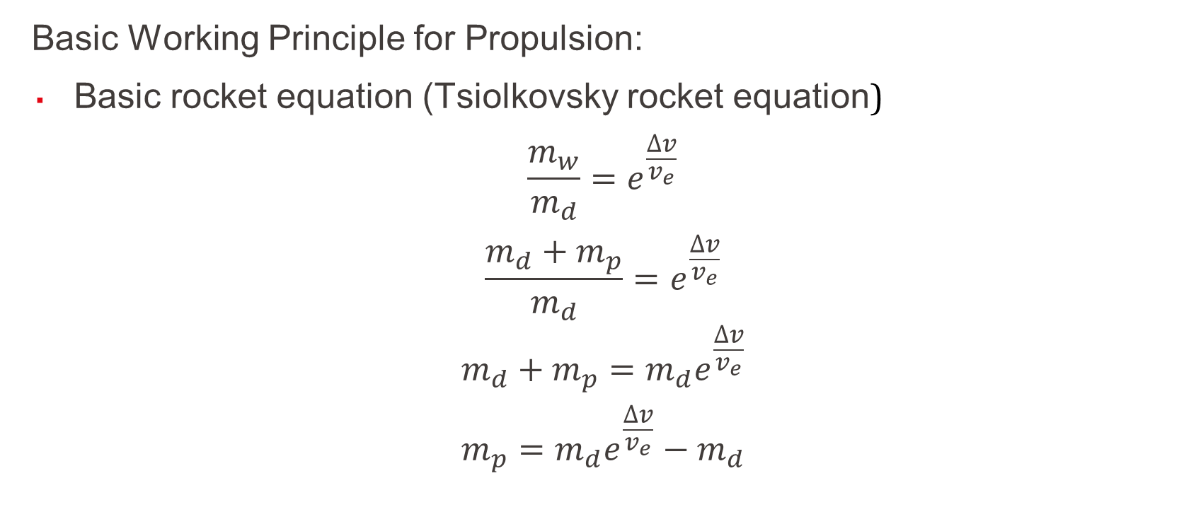
What is the principle of Space Propulsion?
Basic Working Principle for Propulsion:
Basic rocket equation (Tsiolkovsky rocket equation)
$$\frac{m_{w}}{m_{d}}=e^{\frac{∆v}{v_{e}}}$$
$$\frac{m_{d}+m_{p}}{m_{d}}=e^{\frac{∆v}{v_{e}}}$$
$$m_{d}+m_{p}=m_{d}e^{\frac{∆v}{v_{e}}}$$
$$m_{p}=m_{d}e^{\frac{∆v}{v_{e}}}−m_{d}$$
L2 – Propulsion Systems
Space Propulsion ENG-510

Slide 9
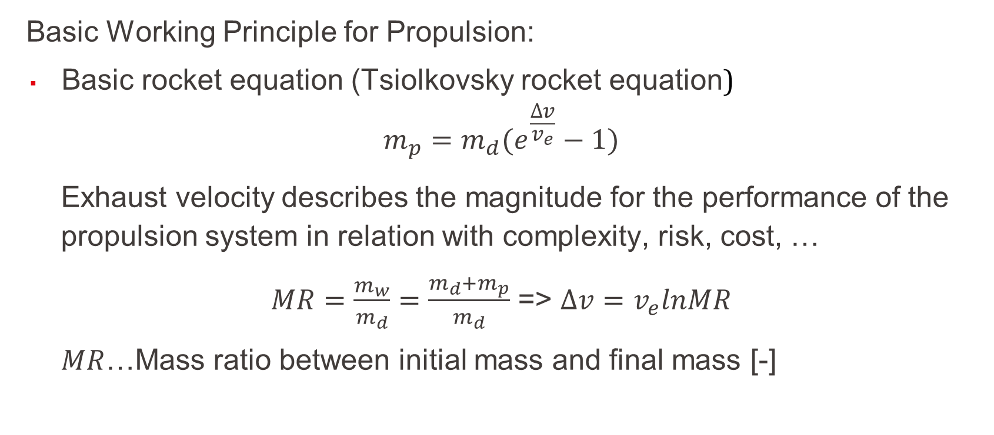
What is the principle of Space Propulsion?
Basic Working Principle for Propulsion:
Basic rocket equation (Tsiolkovsky rocket equation)
$$m_{p}=m_{d}(e^{\frac{∆v}{v_{e}}}−1)$$
Exhaust velocity describes the magnitude for the performance of the propulsion system in relation with complexity, risk, cost, …
$MR=\frac{m_{w}}{m_{d}}=\frac{m_{d}+m_{p}}{m_{d}}$ => $∆v=v_{e}lnMR$
$MR$…Mass ratio between initial mass and final mass [-]
L2 – Propulsion Systems
Space Propulsion ENG-510

Slide 10
What is the principle of Space Propulsion?
Basic Working Principle for Propulsion:
Performance of orbital maneuvers (small changes of orbit trajectory)
Compensation of perturbations (orbit raising to compensate drag losses)
Long duration burns (for significant Δv increases)
Attitude control (with short, directed thrust (impulse, force push) linked to 3-axis control)
Landing burns (for landing on the Moon)
Lift-off burns requiring high thrust levels
L2 – Propulsion Systems
Space Propulsion ENG-510

Slide 11
What is the principle of Space Propulsion?
Basic Working Principle for Propulsion:
Example: How can we maximize the speed of the row boat on the Water?
Example: What was the problem with the Water rocket failing to reach an orbit respectively the targeted altitude of 100 m?
L2 – Propulsion Systems
Space Propulsion ENG-510

Slide 12
What is important on Δv?
Objective: To understand some specific points on Δv
First one must differ between v and Δv
v is the current velocity of a Spacecraft on his trajectory
v could be constant on a circular orbit or changing permanently on an elliptical orbit (w/o any propulsion)
Δv is the impulse which must be given to a Spacecraft to change the trajectory (e.g. change from elliptical to circular orbit or vice-versa)
L2 – Propulsion Systems
Space Propulsion ENG-510

Slide 13
What is important on Δv?
Objective: To understand some specific points on Δv
Δv is not only resulting from space propulsion systems
Δv is not only velocity change but also orbit change
Δv is not only linked to start point and end point only but also on the way between the two points (orbital trajectory)
Δv is not equal to velocity change
Δv is the same for deceleration and acceleration
L2 – Propulsion Systems
Space Propulsion ENG-510

Slide 14
What is important on Δv?
Objective: To understand some specific points on Δv
Δv is not only resulting from space propulsion systems
Δv is not only velocity change but also orbit change
Δv is not only linked to start point and end point only but also on the way between the two points (orbital trajectory)
Δv is not equal to velocity change
Δv is the same for deceleration and acceleration
L2 – Propulsion Systems
Space Propulsion ENG-510

Slide 15
What is important on Δv?
Objective: To understand some specific points on Δv
Δv is not only resulting from space propulsion systems
Δv changes are also given due to drag forces, gravitational forces, … and similar
Example: ISS is altitude is reduced every day by about 50 to 150 m linked to residual drag forces
L2 – Propulsion Systems
Space Propulsion ENG-510

Slide 16
What is important on Δv?
Objective: To understand some specific points on Δv
Δv is not only resulting from space propulsion systems
Δv is not only velocity change but also orbit change
Δv is not only linked to start point and end point only but also on the way between the two points (orbital trajectory)
Δv is not equal to velocity change
Δv is the same for deceleration and acceleration
L2 – Propulsion Systems
Space Propulsion ENG-510

Slide 17
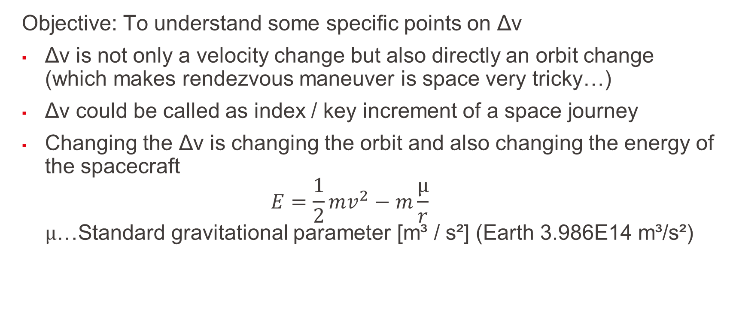
What is important on Δv?
Objective: To understand some specific points on Δv
Δv is not only a velocity change but also directly an orbit change (which makes rendezvous maneuver is space very tricky…)
Δv could be called as index / key increment of a space journey
Changing the Δv is changing the orbit and also changing the energy of the spacecraft $E=\frac{1}{2}mv^{2}−m\frac{μ}{r}$ $μ$…Standard gravitational parameter [m³ / s²] (Earth 3.986E14 m³/s²)
L2 – Propulsion Systems
Space Propulsion ENG-510

Slide 18



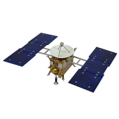



What is important on Δv?
Objective: To understand some specific points on Δv
Important Δv impulse on circular orbit changes the trajectory to an elliptical orbit (assuming escape velocity is not reached) and increasing the energy
L2 – Propulsion Systems
Space Propulsion ENG-510

Slide 19
What is important on Δv?
Objective: To understand some specific points on Δv
On the elliptical orbit the real velocity is permanently changing (as well as radius of flight trajectory) considering the Energy conservation
This velocity change is occurring without any further space propulsion impulse, just linked to the orbital trajectory and the Energy conservation which is described by the vis-viva equation
L2 – Propulsion Systems
Space Propulsion ENG-510

Slide 20
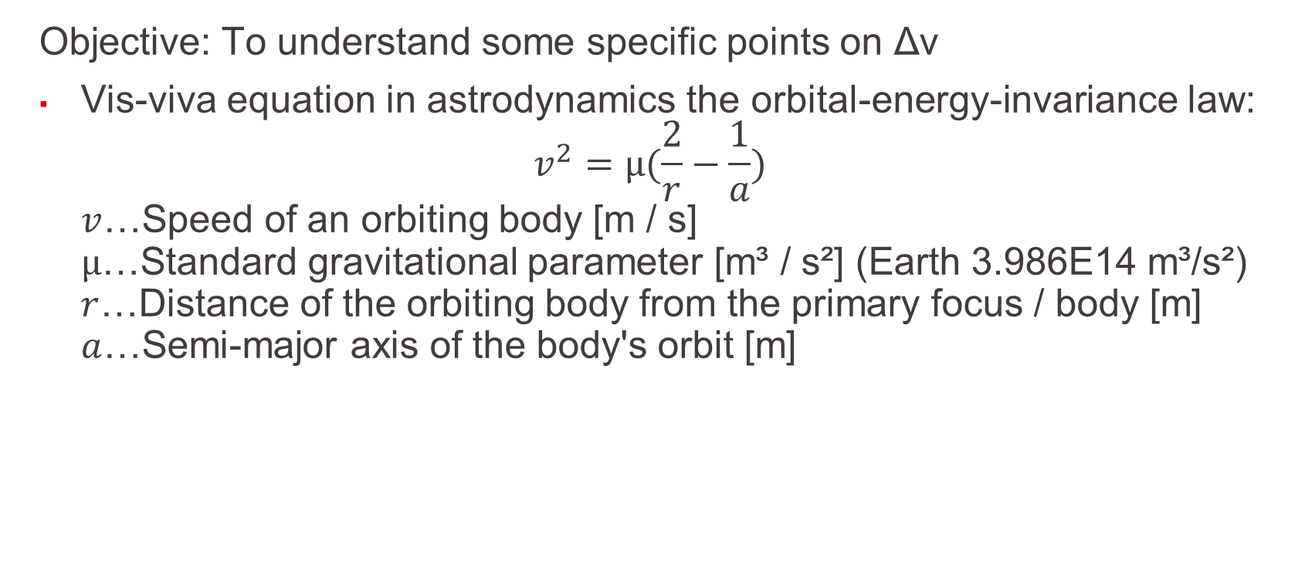
What is important on Δv?
Objective: To understand some specific points on Δv
Vis-viva equation in astrodynamics the orbital-energy-invariance law: $v^{2}=μ(\frac{2}{r}−\frac{1}{a})$ $v$…Speed of an orbiting body [m / s] $μ$…Standard gravitational parameter [m³ / s²] (Earth 3.986E14 m³/s²) $r$…Distance of the orbiting body from the primary focus / body [m] $a$…Semi-major axis of the body's orbit [m]
L2 – Propulsion Systems
Space Propulsion ENG-510

Slide 21
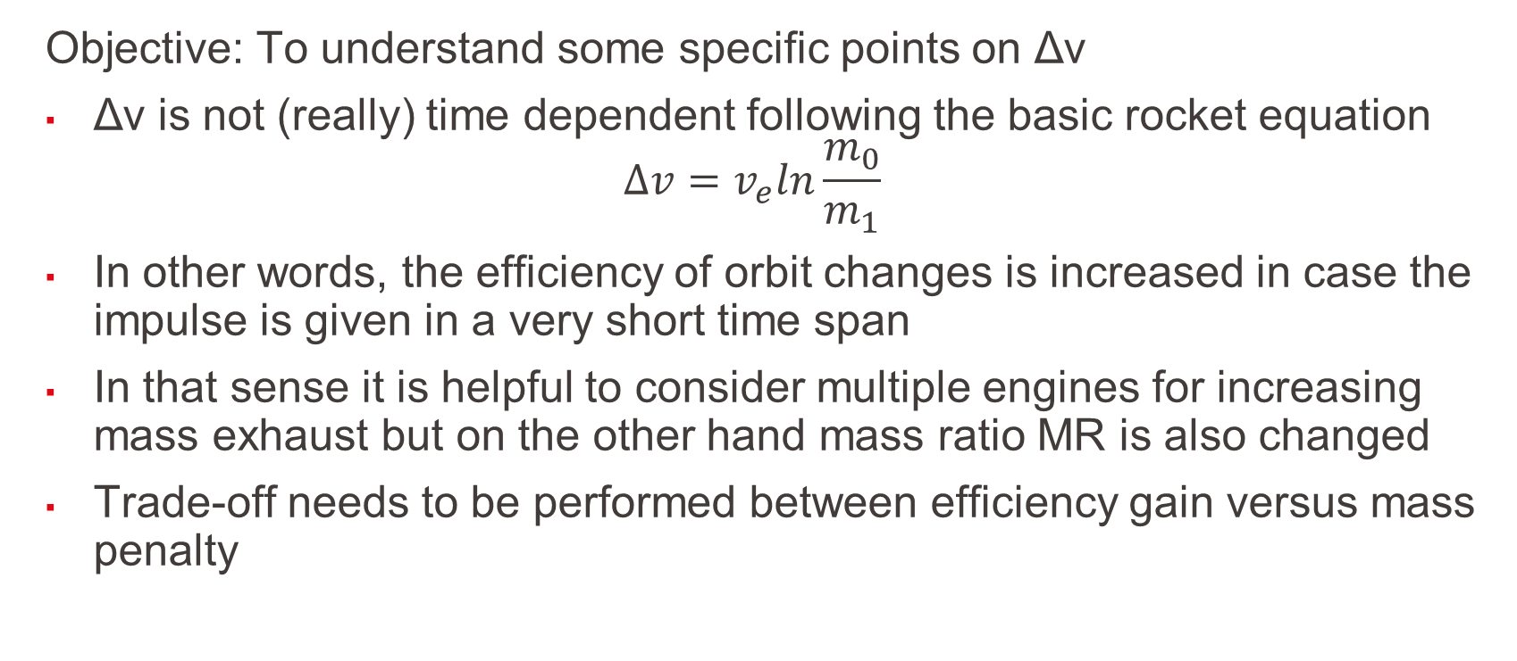
What is important on Δv?
Objective: To understand some specific points on Δv
Δv is not (really) time dependent following the basic rocket equation $∆v=v_{e}ln\frac{m_{0}}{m_{1}}$
In other words, the efficiency of orbit changes is increased in case the impulse is given in a very short time span
In that sense it is helpful to consider multiple engines for increasing mass exhaust but on the other hand mass ratio MR is also changed
Trade-off needs to be performed between efficiency gain versus mass penalty
L2 – Propulsion Systems
Space Propulsion ENG-510

Slide 22
What is important on Δv?
Objective: To understand some specific points on Δv
For same Δv need, the mass ratio (MR) between initial mass (dry mass + propellant mass) to final mass (dry mass) is smaller for higher exhaust velocity (v_{e}), i.e. efficiency is higher
100
v_{e} = 2 km / s
v_{e} = 4 km / s
L2 – Propulsion Systems
Space Propulsion ENG-510
MR [-]
10
v_{e} = 10 km / s
v_{e} = 30 km / s
1
0
20
0
5
10
15
Delta v [km / s]

Slide 23
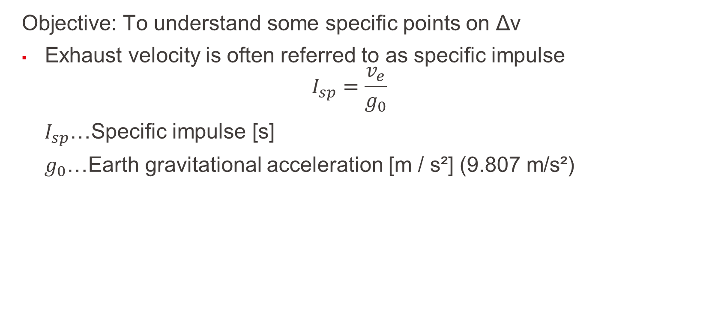
What is important on Δv?
Objective: To understand some specific points on Δv
Exhaust velocity is often referred to as specific impulse
$$I_{sp}=\frac{v_{e}}{g_{0}}$$
$I_{sp}$…Specific impulse [s]
$g_{0}$…Earth gravitational acceleration [m / s²] (9.807 m/s²)
L2 – Propulsion Systems
Space Propulsion ENG-510

Slide 24
What is important on Δv?
Objective: To understand some specific points on Δv
For given mass ratio (MR) between initial mass (dry mass + propellant mass) to final mass (dry mass), maximal achievable Δv is depending on the effective exhaust velocity (v_{e})
Necessary wet mass grows exponentially with the desired Δv
L2 – Propulsion Systems
Space Propulsion ENG-510
MR [-]
Delta v / v exhaust [-]

Slide 25
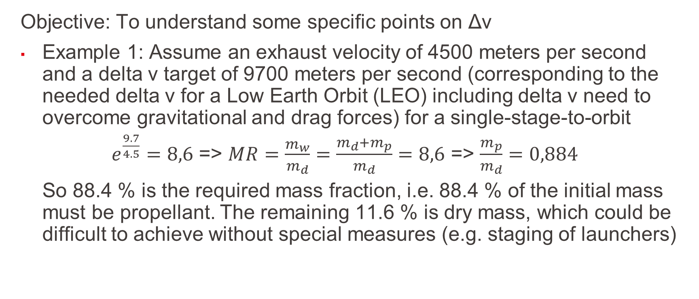
What is important on Δv?
Objective: To understand some specific points on Δv
Example 1: Assume an exhaust velocity of 4500 meters per second and a delta v target of 9700 meters per second (corresponding to the needed delta v for a Low Earth Orbit (LEO) including delta v need to overcome gravitational and drag forces) for a single-stage-to-orbit
$e^{\frac{9.7}{4.5}}=8,6$ => $MR=\frac{m_{w}}{m_{d}}=\frac{m_{d}+m_{p}}{m_{d}}=8,6$ => $\frac{m_{p}}{m_{d}}=0,884$
So 88.4 % is the required mass fraction, i.e. 88.4 % of the initial mass must be propellant. The remaining 11.6 % is dry mass, which could be difficult to achieve without special measures (e.g. staging of launchers)
L2 – Propulsion Systems
Space Propulsion ENG-510

Slide 26
What is important on Δv?
Objective: To understand some specific points on Δv
Example 2: To achieve a delta v of 10 000 meters per second with an exhaust velocity of 2 000 meters per second a mass ratio of 147 is needed and so a required mass fraction of 99,3 %
L2 – Propulsion Systems
Space Propulsion ENG-510

Slide 27
What is important on Δv?
Objective: To understand some specific points on Δv
Δv is not only resulting from space propulsion systems
Δv is not only velocity change but also orbit change
Δv is not only linked to start point and end point only but also on the way between the two points (orbital trajectory)
Δv is not equal to velocity change
Δv is the same for deceleration and acceleration
L2 – Propulsion Systems
Space Propulsion ENG-510

Slide 28
What is important on Δv?
Objective: To understand some specific points on Δv
Δv is not only linked to start point and end point only but also on the way between the two points (orbital trajectory)
Two main different trajectories are discussed hereafter (not considering any change of inclination for simplification [inclination is the angular distance of the orbital plane from the plane of the planet's equator, stated in degrees])
L2 – Propulsion Systems
Space Propulsion ENG-510

Slide 29
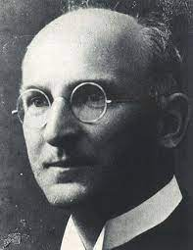
What is important on Δv?
Objective: To understand some specific points on Δv
Two classical orbital changes must be known
Hohmann transfer (impulsive maneuver – two short impulses)
Edelbaum transfer (long duration maneuver with low thrust – spiral orbit raising)
L2 – Propulsion Systems
Hohmann Transfer
Edelbaum Transfer
Space Propulsion ENG-510

Slide 30
What is important on Δv?
Objective: To understand some specific points on Δv
Hohmann transfer is a two-impulse orbit transfer
Acceleration in a period sufficiently smaller than the orbital period
Basic maneuver in chemical propulsion
Transfer from perigee (point close to Earth) to apogee (point far from Earth) on an elliptical trajectory
L2 – Propulsion Systems
Space Propulsion ENG-510

Slide 31




What is important on Δv?
Objective: To understand some specific points on Δv
Δv need for a Hohmann transfer is determined by (as derived from the vis-viva-equation considering instantaneous impulses): $Δv_{1}=\sqrt{\frac{μ}{r_{1}}}\left(\sqrt{\frac{2r_{2}}{r_{1}+r_{2}}}−1\right)$ $Δv_{2}=\sqrt{\frac{μ}{r_{2}}}\left(1−\sqrt{\frac{2r_{1}}{r_{1}+r_{2}}}\right)$ $Δv_{tot}=Δv_{1}$+ $Δv_{2}$
L2 – Propulsion Systems
Space Propulsion ENG-510
Perigee
Apogee

Slide 32
What is important on Δv?
Objective: To understand some specific points on Δv
Example: Δv need for a geostationary transfer considering the Hohmann transfer beginning at r₁ = 6 678 km (altitude 300 km) and ending in a geostationary Earth orbit with r₂ = 42 164 km (altitude 35 786 km)
In the smaller circular orbit, the speed is 7.73 km / s; in the larger one, 3.07 km / s. In the elliptical orbit in between the speed varies from 10.15 km / s at the perigee to 1.61 km / s at the apogee
Therefore, the Δv for the first burn is 10.15 − 7.73 = 2.42 km / s, for the second burn 3.07 − 1.61 = 1.46 km / s, and for both together the total Δv is 3.88 km / s
L2 – Propulsion Systems
Space Propulsion ENG-510

Slide 33
What is important on Δv?
Objective: To understand some specific points on Δv
Spiral orbit raising is a continuous thrust orbit transfer
Basic maneuvers in electric propulsion (Assumptions: tangential thrust, constant thrust and velocity = circular orbit velocity at its radius
L2 – Propulsion Systems
Space Propulsion ENG-510

Slide 34
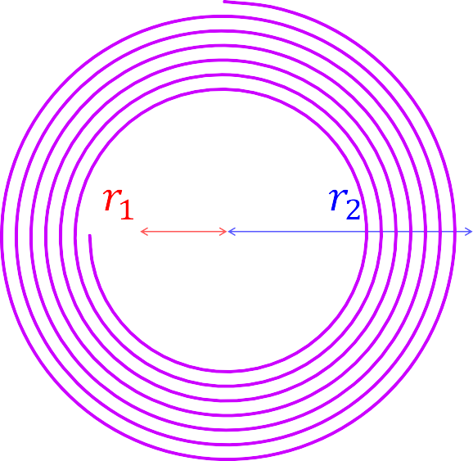

What is important on Δv?
Objective: To understand some specific points on Δv
Δv need for an Edelbaum transfer (spiral orbit raising) is determined by the following equations: $Δv_{1}=\sqrt{\frac{μ}{r_{1}}}$ $Δv_{2}=\sqrt{\frac{μ}{r_{2}}}$ $Δv_{tot}=Δv_{1}−$ $Δv_{2}$
L2 – Propulsion Systems
Space Propulsion ENG-510
Perigee
Apogee

Slide 35
What is important on Δv?
Objective: To understand some specific points on Δv
Example: Δv need for a geostationary transfer considering the Edelbaum transfer beginning at r₁ = 6 678 km (altitude 300 km) and ending in a geostationary Earth orbit with r₂ = 42 164 km (altitude 35 786 km)
In the smaller circular orbit the speed is 7.73 km / s; in the larger one, 3.07 km / s
Therefore the total Δv need for an Edelbaum transfer is 7.73 − 3.07 = 4.66 km / s, so higher compared to a Hohmann transfer requiring a total Δv of 3.88 km / s
L2 – Propulsion Systems
Space Propulsion ENG-510

Slide 36
What is important on Δv?
Objective: To understand some specific points on Δv
Hohmann transfer versus spiral orbit raising
Hohmann transfer is much faster
Hohmann transfer requires high thrust
Δv increase is higher for spiral orbit raising
L2 – Propulsion Systems
Space Propulsion ENG-510

Slide 37
What is important on Δv?
Objective: To understand some specific points on Δv
Δv is not only resulting from space propulsion systems
Δv is not only velocity change but also orbit change
Δv is not only linked to start point and end point only but also on the way between the two points (orbital trajectory)
Δv is not equal to velocity change
Δv is the same for deceleration and acceleration
L2 – Propulsion Systems
Space Propulsion ENG-510

Slide 38
What is important on Δv?
Objective: To understand some specific points on Δv
Δv is not equal to velocity change
Δv and actual velocity depend on the orbit like for LEO (ℎ = 420 km, 𝑣 = 7.66 km/s)
Assuming continuous thrust in the direction of acceleration
Altitude will increase, but “velocity” will decrease in this circular orbit raise (ℎ = 620 km, 𝑣 = 7.55 km/s)
Also as stated before, Energy will increase
L2 – Propulsion Systems
Space Propulsion ENG-510

Slide 39
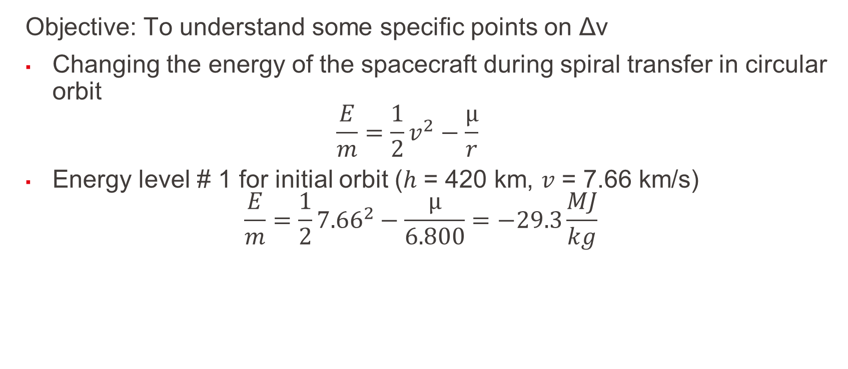
What is important on Δv?
Objective: To understand some specific points on Δv
Changing the energy of the spacecraft during spiral transfer in circular orbit $\frac{E}{m}=\frac{1}{2}v^{2}−\frac{μ}{r}$
Energy level # 1 for initial orbit (ℎ = 420 km, 𝑣 = 7.66 km/s) $\frac{E}{m}=\frac{1}{2}{7.66}^{2}−\frac{μ}{6.800}=−29.3\frac{MJ}{kg}$
L2 – Propulsion Systems
Space Propulsion ENG-510

Slide 40
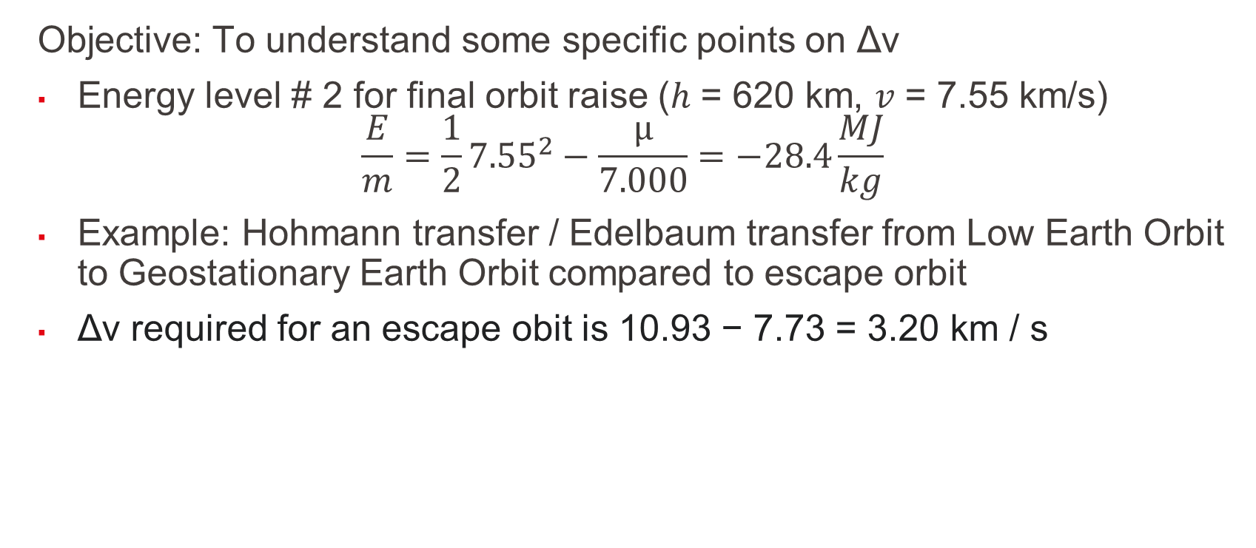
What is important on Δv?
Objective: To understand some specific points on Δv
Energy level # 2 for final orbit raise (ℎ = 620 km, 𝑣 = 7.55 km/s) $\frac{E}{m}=\frac{1}{2}{7.55}^{2}−\frac{μ}{7.000}=−28.4\frac{MJ}{kg}$
Example: Hohmann transfer / Edelbaum transfer from Low Earth Orbit to Geostationary Earth Orbit compared to escape orbit
Δv required for an escape obit is 10.93 − 7.73 = 3.20 km / s
L2 – Propulsion Systems
Space Propulsion ENG-510

Slide 41
What is important on Δv?
Objective: To understand some specific points on Δv
Applying a Δv at LEO of only 0.78 km / s more (3.20 − 2.42) would give the rocket the escape velocity, which is less than the Δv of 1.46 km / s required to circularize the geosynchronous orbit
This illustrates the Oberth effect, that at large speeds the same Δv provides more specific orbital energy, and energy increase is maximized if one spends the Δv as quickly as possible, rather than spending some, being decelerated by gravity, and then spending some more to overcome the deceleration
L2 – Propulsion Systems
Space Propulsion ENG-510

Slide 42
What is important on Δv?
Objective: To understand some specific points on Δv
Δv is not only resulting from space propulsion systems
Δv is not only velocity change but also orbit change
Δv is not only linked to start point and end point only but also on the way between the two points (orbital trajectory)
Δv is not equal to velocity change
Δv is the same for deceleration and acceleration
L2 – Propulsion Systems
Space Propulsion ENG-510

Slide 43
What is important on Δv?
Objective: To understand some specific points on Δv
Δv is the same for deceleration and acceleration
Δv is the same going from LEO to GEO or from GEO to LEO
One transfer is only supported by acceleration whereas the other one is referring to deceleration
L2 – Propulsion Systems
Space Propulsion ENG-510

Slide 44
What is important on Δv?
Objective: To understand some specific points on Δv
Δv is the same for deceleration and acceleration
One can reach Mars by escaping the Earth with Δv of + 2.9 km / s
L2 – Propulsion Systems
Space Propulsion ENG-510

Slide 45
What is important on Δv?
Objective: To understand some specific points on Δv
One can reach Venus by escaping the Earth with Δv of - 2.5 km / s as a deceleration maneuver
Deceleration is not easy at all, but completely same effort is needed as for acceleration (while traveling on the Earth we do have already a certain velocity…)
L2 – Propulsion Systems
Space Propulsion ENG-510

Slide 46
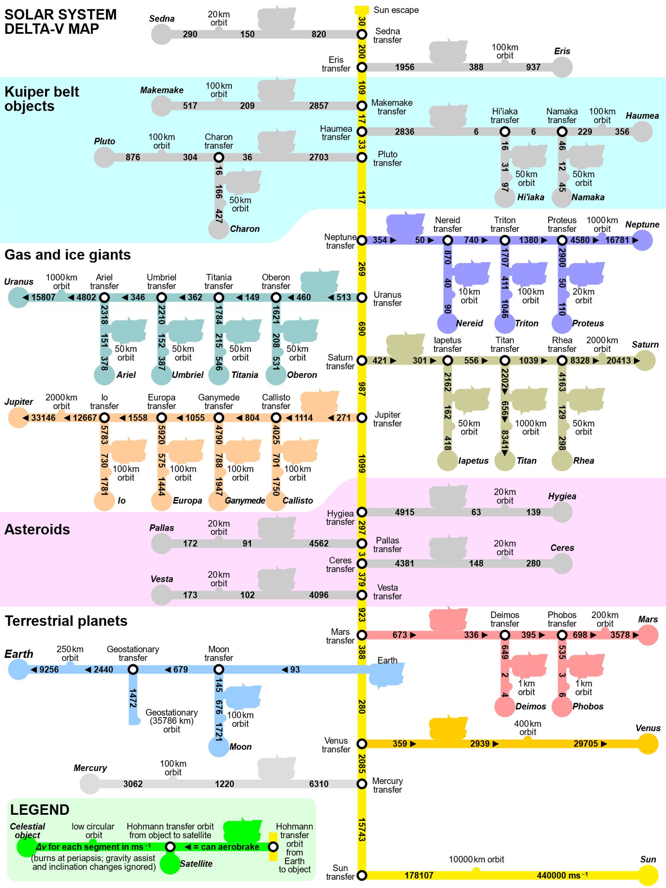
What is important on Δv?
L2 – Propulsion Systems
Space Propulsion ENG-510

Slide 47
What is important on Δv?
Objective: To understand some specific points on Δv
Δv is key parameter for understanding of space journeys, but
Δv is not the only parameter…
L2 – Propulsion Systems
Space Propulsion ENG-510

Slide 48
What is the importance of thrust?
Objective: To discuss thrust + relation to Isp
How thrust is produced?
How efficiently thrust can be produced?
How thrust and thrust efficiency affect the vehicle mass in terms of:
Propellant mass?
Inert mass required to hold the propellant and provide the thrust?
Some key topics related to thrust:
Launcher versus Satellite propulsion
Thrust level on ground
Minimization of propellant mass and therefore maximizing of c (efficiency)
L2 – Propulsion Systems
Space Propulsion ENG-510

Slide 49
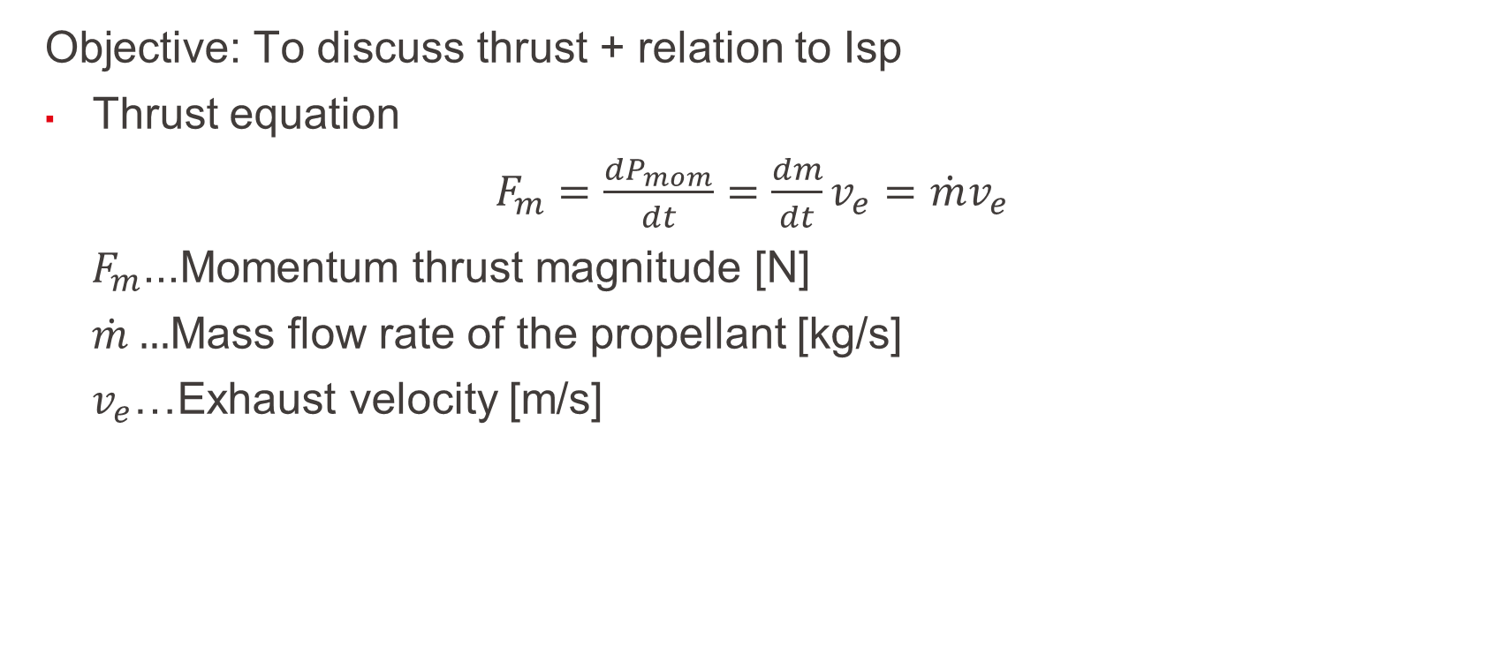
What is the importance of thrust?
Objective: To discuss thrust + relation to Isp
Thrust equation
$F_{m}=\frac{dP_{mom}}{dt}=\frac{dm}{dt}v_{e}=$ ${\dot{m}v}_{e}$
$F_{m}$...Momentum thrust magnitude [N]
$\dot{m}…$Mass flow rate of the propellant [kg/s]
$v_{e}$…Exhaust velocity [m/s]
L2 – Propulsion Systems
Space Propulsion ENG-510

Slide 50
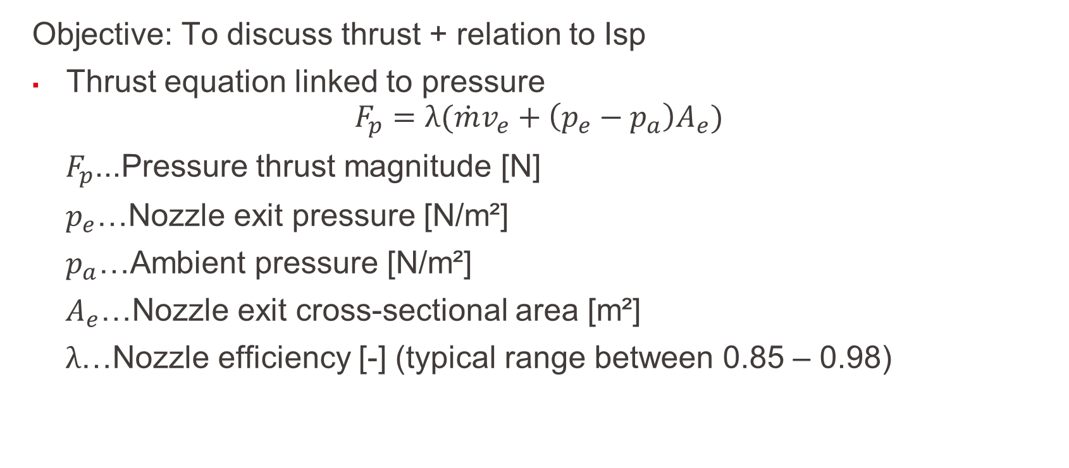
What is the importance of thrust?
Objective: To discuss thrust + relation to Isp
Thrust equation linked to pressure
$$F_{p}=λ({\dot{m}v}_{e}+\left(p_{e}−p_{a}\right)A_{e})$$
$F_{p}$...Pressure thrust magnitude [N]
$p_{e}$…Nozzle exit pressure [N/m²]
$p_{a}$…Ambient pressure [N/m²]
$A_{e}$…Nozzle exit cross-sectional area [m²]
$λ$…Nozzle efficiency [-] (typical range between 0.85 – 0.98)
L2 – Propulsion Systems
Space Propulsion ENG-510

Slide 51
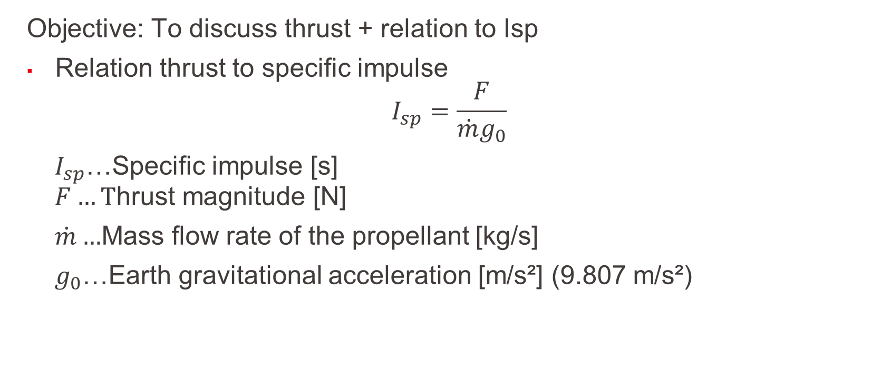
What is the importance of thrust?
Objective: To discuss thrust + relation to Isp
Relation thrust to specific impulse
$$I_{sp}=\frac{F}{{\dot{m}g}_{0}}$$
$I_{sp}$…Specific impulse [s]
$$F…T\text{hrust} \text{magnitude}\text{ [}\text{N}\text{] }$$
$\dot{m}…$Mass flow rate of the propellant [kg/s]
$g_{0}$…Earth gravitational acceleration [m/s²] (9.807 m/s²)
L2 – Propulsion Systems
Space Propulsion ENG-510

Slide 52

What is the importance of thrust?
Objective: To discuss thrust + relation to Isp
Effective exhaust velocity
$c=v_{e}+$ $\frac{\left(p_{e}−p_{a}\right)A_{e}}{\dot{m}}$
$c$…Effective exhaust velocity [m/s]
$$F_{m}=\dot{m}c$$
$$c=I_{sp}g_{0}$$
L2 – Propulsion Systems
Space Propulsion ENG-510

Slide 53
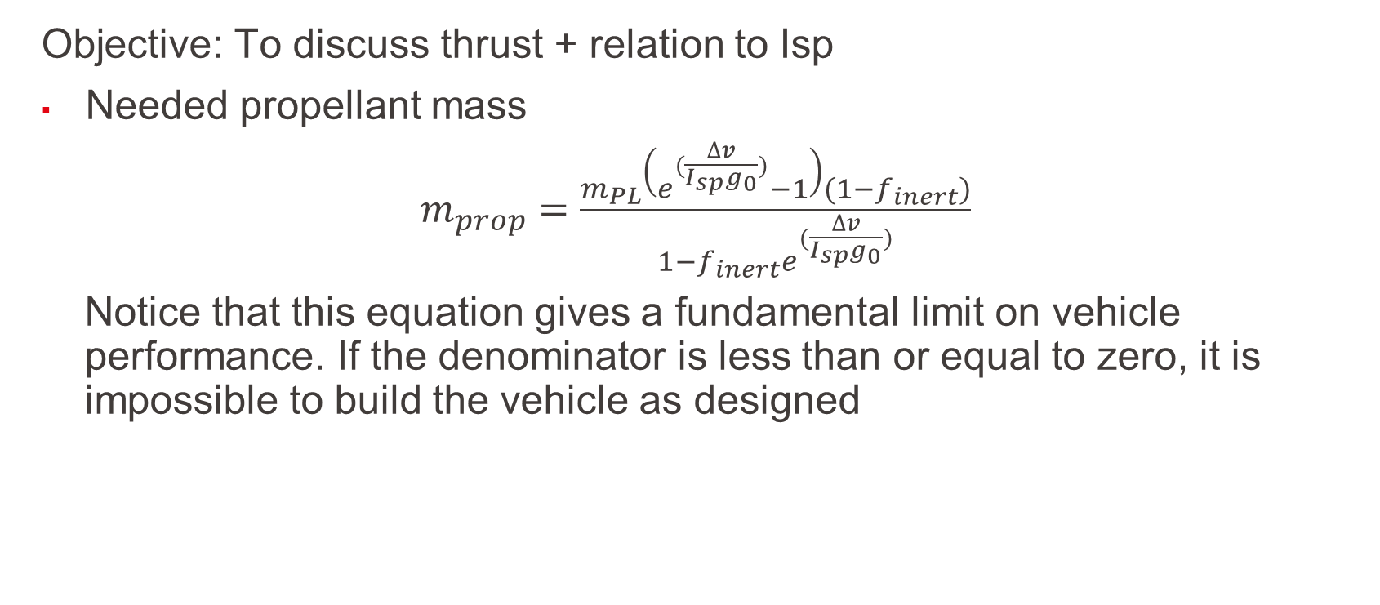
What is the importance of thrust?
Objective: To discuss thrust + relation to Isp
Needed propellant mass
$m_{prop}=$ $\frac{m_{PL}\left(e^{(\frac{∆v}{I_{sp}g_{0}})}−1\right)(1−f_{inert})}{1−f_{inert}e^{(\frac{∆v}{I_{sp}g_{0}})}}$
Notice that this equation gives a fundamental limit on vehicle performance. If the denominator is less than or equal to zero, it is impossible to build the vehicle as designed
L2 – Propulsion Systems
Space Propulsion ENG-510

Slide 54
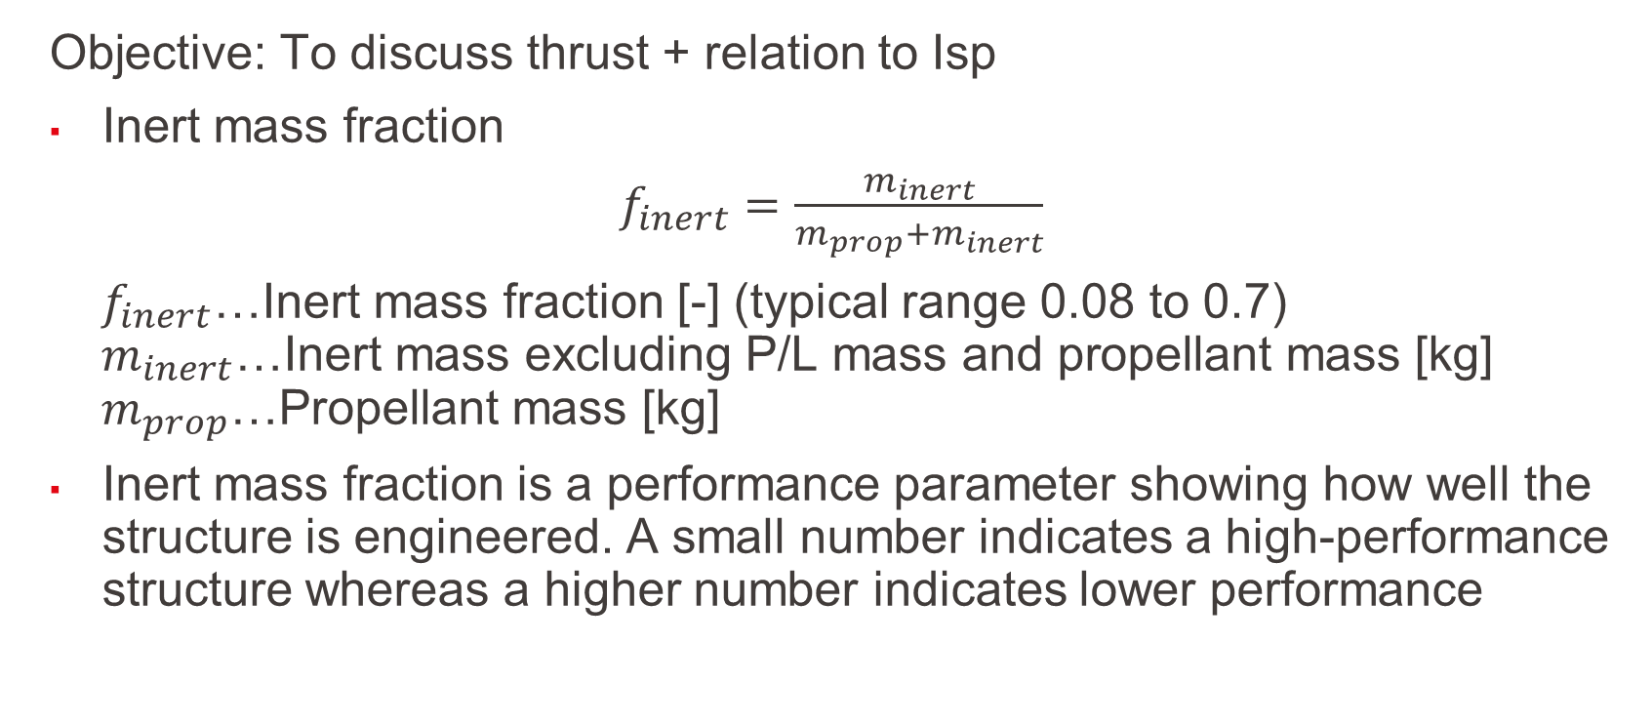
What is the importance of thrust?
Objective: To discuss thrust + relation to Isp
Inert mass fraction
$f_{inert}=$ $\frac{m_{inert}}{m_{prop}+m_{inert}}$
$f_{inert}$…Inert mass fraction [-] (typical range 0.08 to 0.7)
$$m_{inert}\text{…}\text{Inert} \text{mass} \text{excluding} \text{P}\text{/}\text{L} \text{mass} \text{and} \text{propellant} \text{mass} \text{[}\text{kg}\text{]}$$
$$m_{prop}\text{…}\text{P}\text{ropellant} \text{mass} \text{[}\text{kg}\text{]}$$
Inert mass fraction is a performance parameter showing how well the structure is engineered. A small number indicates a high-performance structure whereas a higher number indicates lower performance
L2 – Propulsion Systems
Space Propulsion ENG-510

Slide 55
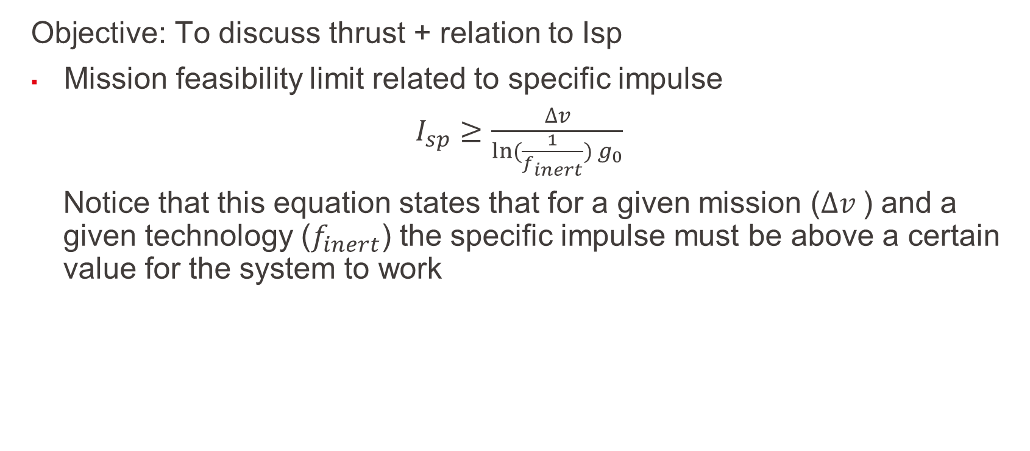
What is the importance of thrust?
Objective: To discuss thrust + relation to Isp
Mission feasibility limit related to specific impulse
$I_{sp}≥$ $\frac{∆v}{ln⁡(\frac{1}{f_{inert}}) g_{0}}$
Notice that this equation states that for a given mission ($∆v$) and a given technology ($f_{inert}$) the specific impulse must be above a certain value for the system to work
L2 – Propulsion Systems
Space Propulsion ENG-510

Slide 56
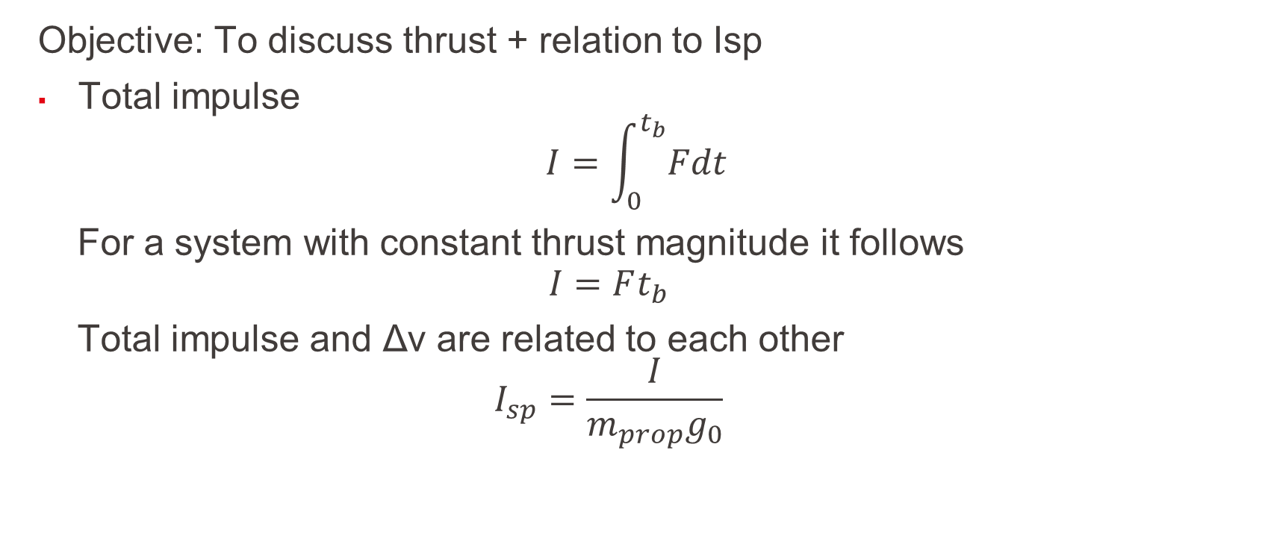
What is the importance of thrust?
Objective: To discuss thrust + relation to Isp
Total impulse
$$I=\int_{0}^{t_{b}}{Fdt}$$
For a system with constant thrust magnitude it follows
$$I=Ft_{b}$$
Total impulse and Δv are related to each other $$I_{sp}=\frac{I}{m_{prop}g_{0}}$$
L2 – Propulsion Systems
Space Propulsion ENG-510

Slide 57
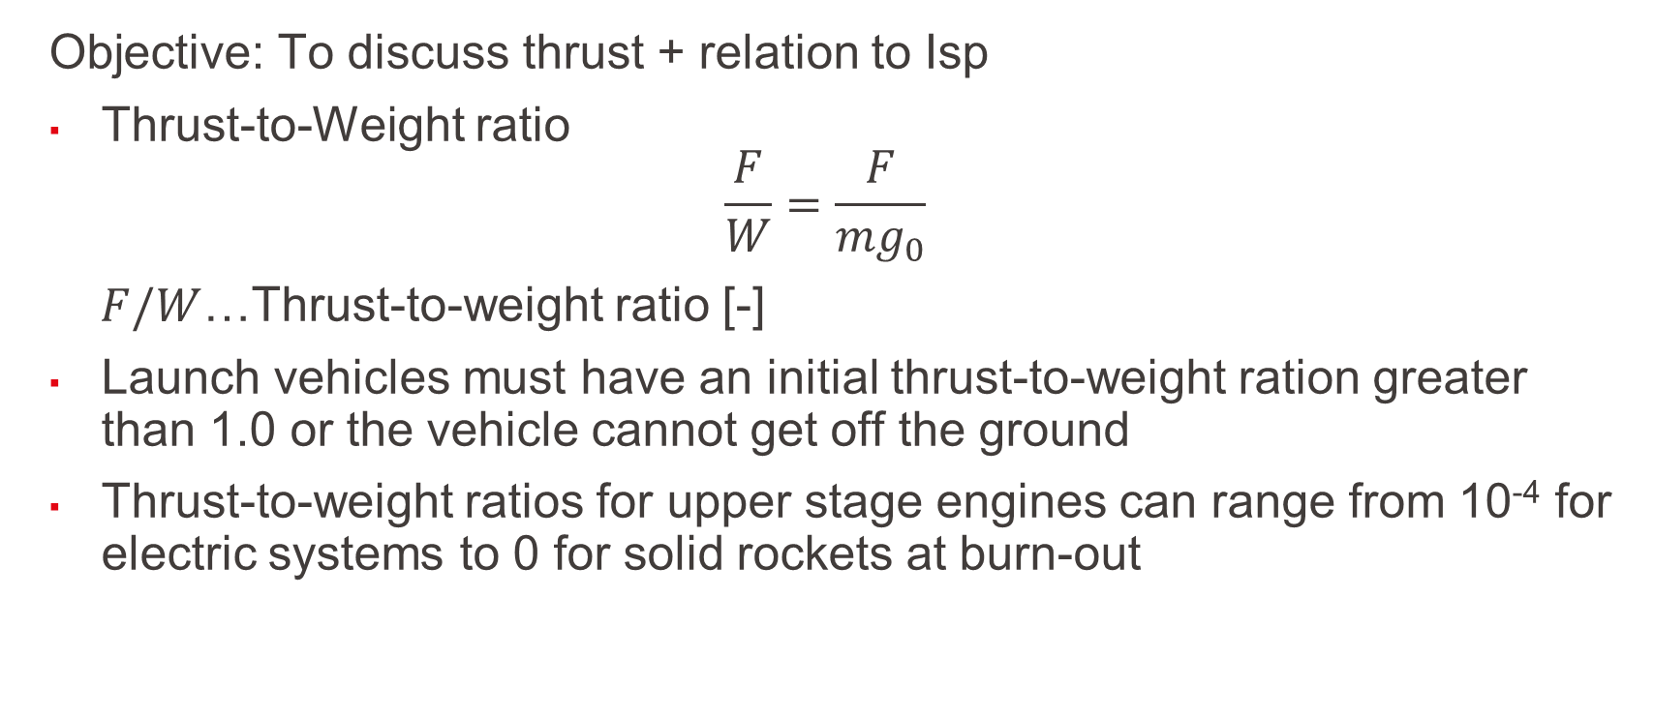
What is the importance of thrust?
Objective: To discuss thrust + relation to Isp
Thrust-to-Weight ratio
$$\frac{F}{W}=\frac{F}{{mg}_{0}}$$
$F/W$…Thrust-to-weight ratio [-]
Launch vehicles must have an initial thrust-to-weight ration greater than 1.0 or the vehicle cannot get off the ground
Thrust-to-weight ratios for upper stage engines can range from 10⁻⁴ for electric systems to 0 for solid rockets at burn-out
L2 – Propulsion Systems
Space Propulsion ENG-510

Slide 58
What is the importance of thrust?
Engine | Launcher | Propellant | Exhaust Velocity | Thrust
F1 | Saturn V | LOx / RP-1 | 3.0 km / s | 7.7 MN
RD-107 | Soyuz | LOx / RP-1 | 3.1 km / s | 1.0 MN
RD-264 | Dnepr | NTO / UDMH | 3.2 km / s | 4.5 MN
SSME | Shuttle | LOx / LH2 | 4.5 km / s | 2.2 MN
LE7A | H2A | LOx / LH2 | 4.3 km / s | 1.1 MN
Vulcain 2 | Ariane 5 | LOx / LH2 | 4.3 km / s | 1.3 MN
SSRB | Shuttle | Composite | 2.7 km / s | 13.8 MN
SRB-A | H2A | Composite | 2.8 km / s | 2.3 MN
M-V-1 | M-V | Composite | 2.8 km / s | 2.4 MN
Objective: To discuss thrust + relation to Isp
How thrust is produced?
How efficiently thrust can be produced?
How thrust and thrust efficiency affect the vehicle mass in terms of:
Propellant mass?
Inert mass required to hold the propellant and provide the thrust?
Some key topics related to thrust:
Launcher versus Satellite propulsion
Thrust level on ground
Minimization of propellant mass and therefore maximizing of c (efficiency)
L2 – Propulsion Systems
Space Propulsion ENG-510

Slide 59
Which general Performance Equations are given?
Objective: To analyze propulsion systems performance
Key equations are given in this section for launcher performance analysis
L2 – Propulsion Systems
Space Propulsion ENG-510

Slide 60
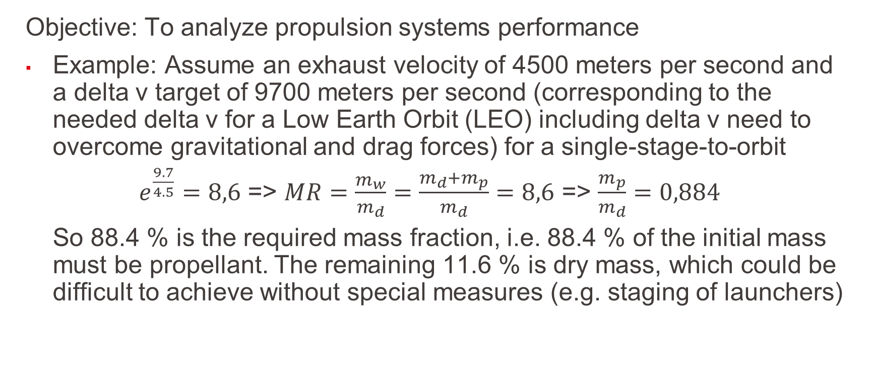
Which general Performance Equations are given?
Objective: To analyze propulsion systems performance
Example: Assume an exhaust velocity of 4500 meters per second and a delta v target of 9700 meters per second (corresponding to the needed delta v for a Low Earth Orbit (LEO) including delta v need to overcome gravitational and drag forces) for a single-stage-to-orbit
$e^{\frac{9.7}{4.5}}=8,6$ => $MR=\frac{m_{w}}{m_{d}}=\frac{m_{d}+m_{p}}{m_{d}}=8,6$ => $\frac{m_{p}}{m_{d}}=0,884$
So 88.4 % is the required mass fraction, i.e. 88.4 % of the initial mass must be propellant. The remaining 11.6 % is dry mass, which could be difficult to achieve without special measures (e.g. staging of launchers)
L2 – Propulsion Systems
Space Propulsion ENG-510

Slide 61
Which general Performance Equations are given?
Objective: To analyze propulsion systems performance
First part is linked to launcher staging
A multistage rocket or step rocket is a launch vehicle that uses two or more rocket stages, each of which contains its own engines and propellant
A tandem or serial stage is mounted on top of another stage; a parallel stage is attached alongside another stage
The result is effectively two or more rockets stacked on top of or attached next to each other
L2 – Propulsion Systems
Space Propulsion ENG-510

Slide 62
Which general Performance Equations are given?
Objective: To analyze propulsion systems performance
Two-stage rockets are quite common, but rockets with as many as five separate stages have been successfully launched
By jettisoning stages when they run out of propellant, the mass of the remaining rocket is decreased
Each successive stage can also be optimized for its specific operating conditions, such as decreased atmospheric pressure at higher altitudes
Staging allows the thrust of the remaining stages to more easily accelerate the rocket to its final orbit
L2 – Propulsion Systems
Space Propulsion ENG-510

Slide 63
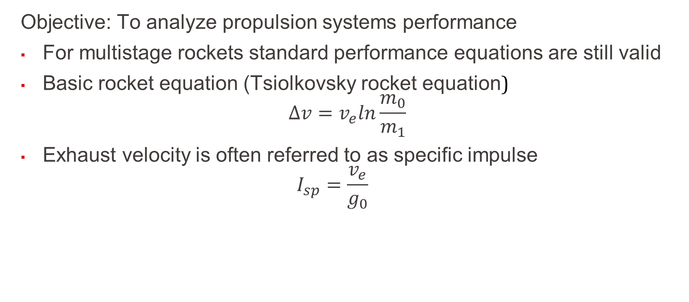
Which general Performance Equations are given?
Objective: To analyze propulsion systems performance
For multistage rockets standard performance equations are still valid
Basic rocket equation (Tsiolkovsky rocket equation)
$$∆v=v_{e}ln\frac{m_{0}}{m_{1}}$$
Exhaust velocity is often referred to as specific impulse
$$I_{sp}=\frac{v_{e}}{g_{0}}$$
L2 – Propulsion Systems
Space Propulsion ENG-510

Slide 64
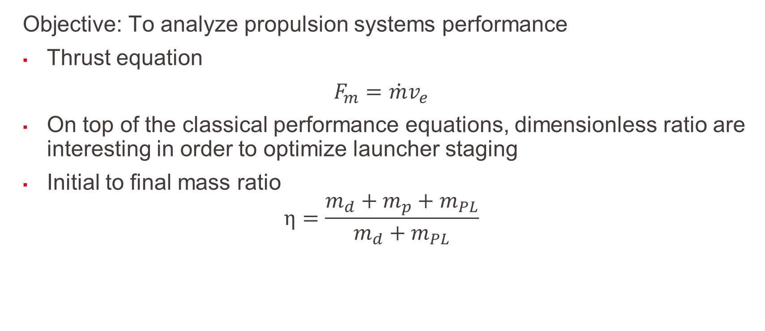
Which general Performance Equations are given?
Objective: To analyze propulsion systems performance
Thrust equation
$F_{m}=$ ${\dot{m}v}_{e}$
On top of the classical performance equations, dimensionless ratio are interesting in order to optimize launcher staging
Initial to final mass ratio
$$η=\frac{m_{d}+m_{p}+m_{PL}}{m_{d}+m_{PL}}$$
L2 – Propulsion Systems
Space Propulsion ENG-510

Slide 65
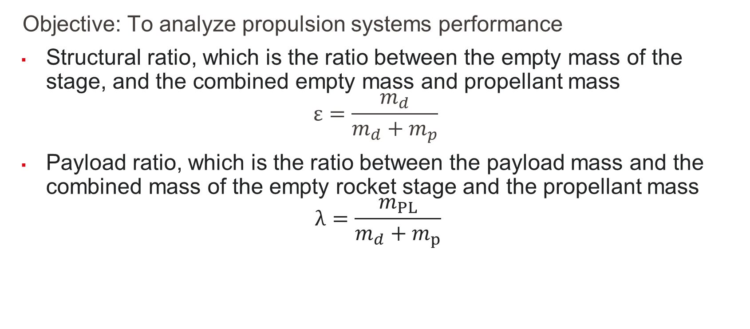
Which general Performance Equations are given?
Objective: To analyze propulsion systems performance
Structural ratio, which is the ratio between the empty mass of the stage, and the combined empty mass and propellant mass
$$ε=\frac{m_{d}}{m_{d}+m_{p}}$$
Payload ratio, which is the ratio between the payload mass and the combined mass of the empty rocket stage and the propellant mass
$$λ=\frac{m_{PL}}{m_{d}+m_{p}}$$
L2 – Propulsion Systems
Space Propulsion ENG-510

Slide 66
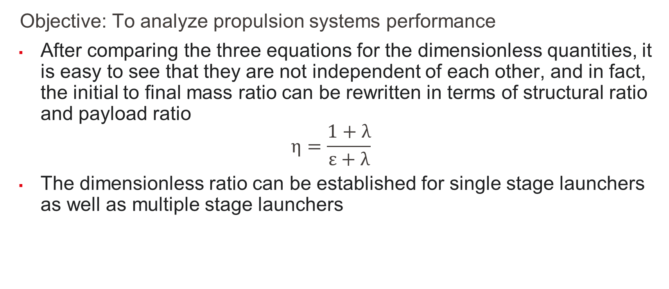
Which general Performance Equations are given?
Objective: To analyze propulsion systems performance
After comparing the three equations for the dimensionless quantities, it is easy to see that they are not independent of each other, and in fact, the initial to final mass ratio can be rewritten in terms of structural ratio and payload ratio
$$η=\frac{1+λ}{ε+λ}$$
The dimensionless ratio can be established for single stage launchers as well as multiple stage launchers
L2 – Propulsion Systems
Space Propulsion ENG-510

Slide 67
Which general Performance Equations are given?
Objective: To analyze propulsion systems performance
Example: Multi-stage launcher with ε = 0.15
L2 – Propulsion Systems
Space Propulsion ENG-510

Slide 68
Which general Performance Equations are given?
Objective: To analyze propulsion systems performance
Example: Multi-stage launcher with ε = 0.10
L2 – Propulsion Systems
Space Propulsion ENG-510

Slide 69
Which general Performance Equations are given?
Objective: To analyze propulsion systems performance
Performance analysis for a tandem or serial stage is very simple as only one propulsion system is acting at a certain time with clear performance parameter like thrust, specific impulse
It must only be determined when stages are jettisoned
The result is effectively two or more rockets stacked on top of or attached next to each other
Performance analysis for a parallel stage is more tricky
L2 – Propulsion Systems
Space Propulsion ENG-510

Slide 70
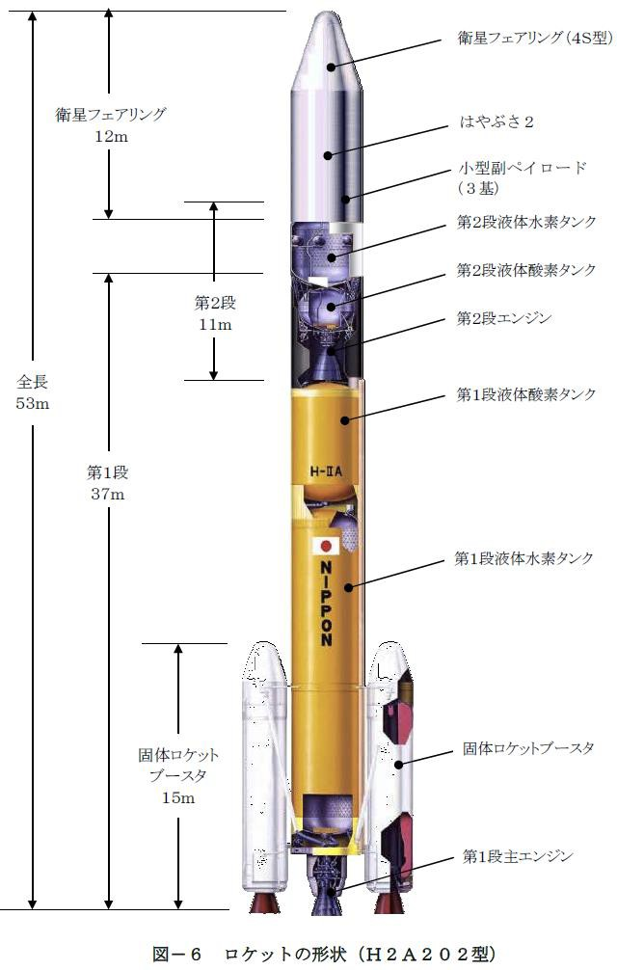
Which general Performance Equations are given?
Objective: To analyze propulsion systems performance
Example: H2A launch vehicle with liquid main engine LE7A with exhaust velocity of 4.31 km / s and two solid rocket booster SRB with exhaust velocity of 2.78 km / s
L2 – Propulsion Systems
Space Propulsion ENG-510

Slide 71
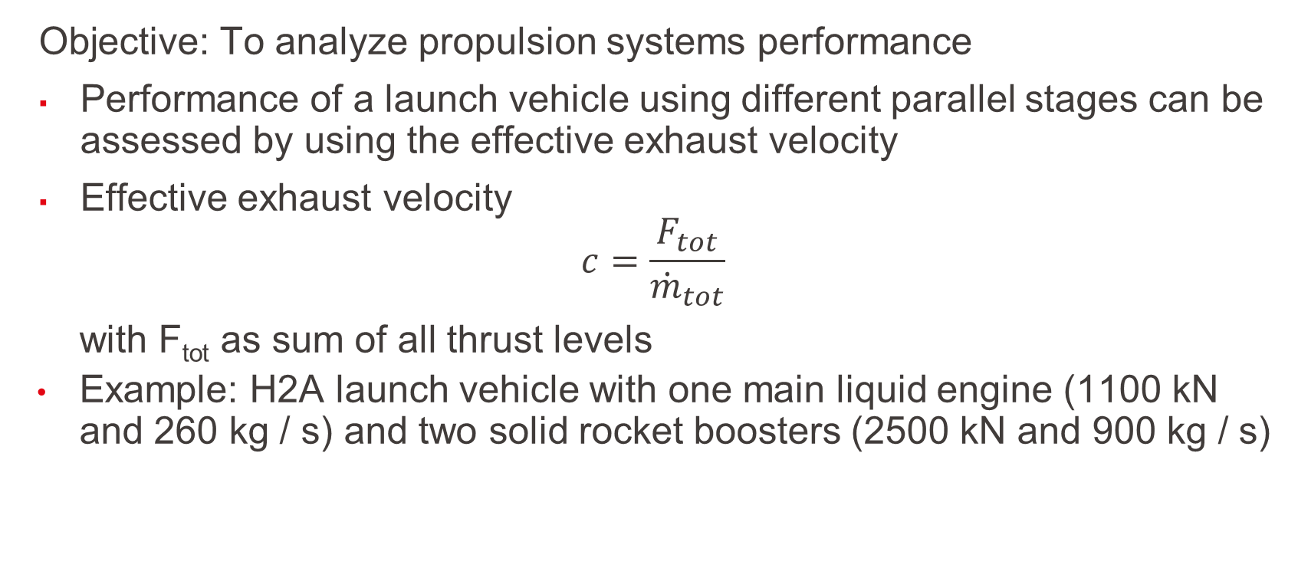
Which general Performance Equations are given?
Objective: To analyze propulsion systems performance
Performance of a launch vehicle using different parallel stages can be assessed by using the effective exhaust velocity
Effective exhaust velocity
$$c=\frac{F_{tot}}{{\dot{m}}_{tot}}$$
with F_{tot} as sum of all thrust levels
Example: H2A launch vehicle with one main liquid engine (1100 kN and 260 kg / s) and two solid rocket boosters (2500 kN and 900 kg / s)
L2 – Propulsion Systems
Space Propulsion ENG-510

Slide 72

Which general Performance Equations are given?
Objective: To analyze propulsion systems performance
Example: H2A launch vehicle performance
Effective exhaust velocity
$$c=\frac{(1100+2500+2500)}{(260+900+900)}=2.96 \frac{km}{s}$$
L2 – Propulsion Systems
Space Propulsion ENG-510

Slide 73
Which general Performance Equations are given?
Objective: To analyze propulsion systems performance
Second part is linked to engine / throat / nozzle performance with flow parameter ρ…density, p…pressure, T…temperature and v…velocity
L2 – Propulsion Systems
Space Propulsion ENG-510

Slide 74
Which general Performance Equations are given?
Objective: To analyze propulsion systems performance
Basic considerations are:
Steady flow: All flow variables are independent on the time
Quasi-1D flow: All flow variables are function of the axial coordinate
Adiabatic flow: No heat transfer to the flow
Ideal gas relation is given
No viscosity: No momentum loss to the wall
L2 – Propulsion Systems
Space Propulsion ENG-510

Slide 75
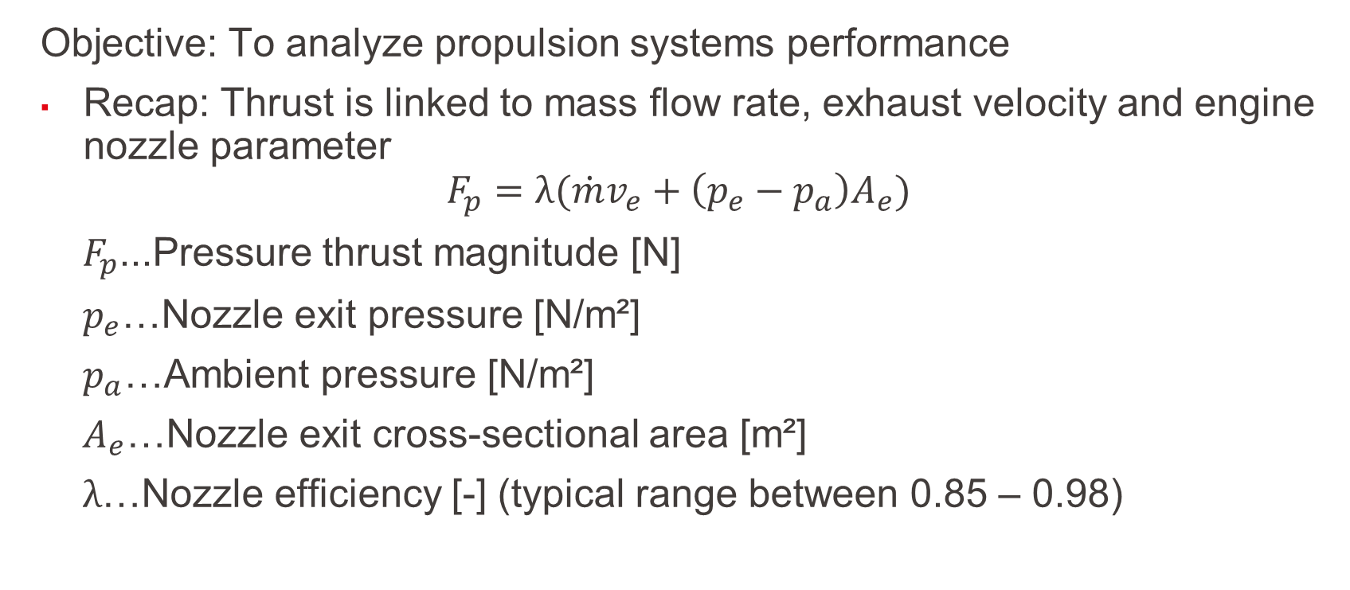
Which general Performance Equations are given?
Objective: To analyze propulsion systems performance
Recap: Thrust is linked to mass flow rate, exhaust velocity and engine nozzle parameter
$$F_{p}=λ({\dot{m}v}_{e}+\left(p_{e}−p_{a}\right)A_{e})$$
$F_{p}$...Pressure thrust magnitude [N]
$p_{e}$…Nozzle exit pressure [N/m²]
$p_{a}$…Ambient pressure [N/m²]
$A_{e}$…Nozzle exit cross-sectional area [m²]
$λ$…Nozzle efficiency [-] (typical range between 0.85 – 0.98)
L2 – Propulsion Systems
Space Propulsion ENG-510

Slide 76
Which general Performance Equations are given?
Objective: To analyze propulsion systems performance
Recap: Thrust is linked to mass flow rate, exhaust velocity and engine nozzle parameter
L2 – Propulsion Systems
Space Propulsion ENG-510

Slide 77
Which general Performance Equations are given?
Objective: To analyze propulsion systems performance
Recap: Thrust is linked to mass flow rate, exhaust velocity and engine nozzle parameter
L2 – Propulsion Systems
Space Propulsion ENG-510

Slide 78
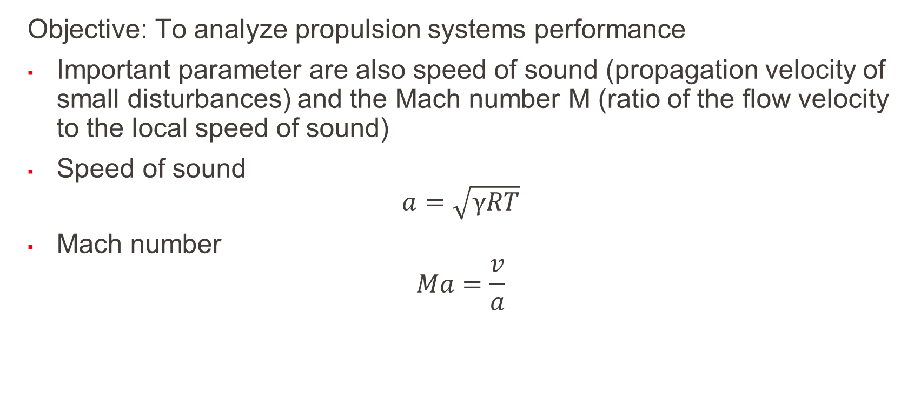
Which general Performance Equations are given?
Objective: To analyze propulsion systems performance
Important parameter are also speed of sound (propagation velocity of small disturbances) and the Mach number M (ratio of the flow velocity to the local speed of sound)
Speed of sound
$$a=\sqrt{γRT}$$
Mach number
$$Ma=\frac{v}{a}$$
L2 – Propulsion Systems
Space Propulsion ENG-510

Slide 79
Which general Performance Equations are given?
Objective: To analyze propulsion systems performance
Ma number is important in terms of flow acceleration / deceleration for different nozzle types
L2 – Propulsion Systems
Space Propulsion ENG-510
Ma < 1
Ma > 1

Slide 80
Which general Performance Equations are given?
Objective: To analyze propulsion systems performance
Once the flow reaches to Ma = 1 at the throat (= choked conditions), only downstream conditions determine the flow rate
L2 – Propulsion Systems
Space Propulsion ENG-510

Slide 81
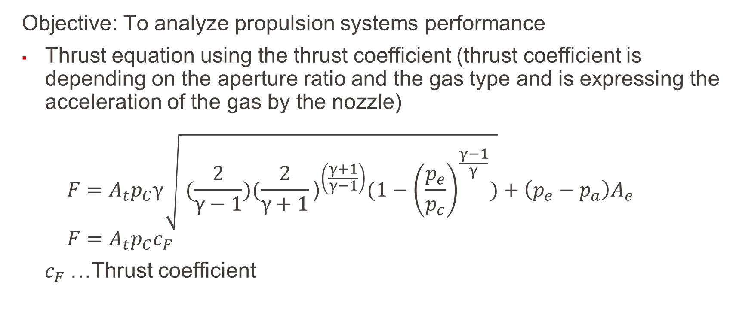
Which general Performance Equations are given?
Objective: To analyze propulsion systems performance
Thrust equation using the thrust coefficient (thrust coefficient is depending on the aperture ratio and the gas type and is expressing the acceleration of the gas by the nozzle) $F=A_{t}p_{C}γ\sqrt{ (\frac{2}{γ−1}){(\frac{2}{γ+1}\text{)}}^{\left(\frac{γ+1}{γ−1}\right)}(1−{\left(\frac{p_{e}}{p_{c}}\right)}^{\frac{γ−1}{γ}})}+\left(p_{e}−p_{a}\right)A_{e}$ $F=A_{t}p_{C}c_{F}$
$c_{F}$…Thrust coefficient
L2 – Propulsion Systems
Space Propulsion ENG-510

Slide 82
Which general Performance Equations are given?
L2 – Propulsion Systems
Space Propulsion ENG-510

Slide 83
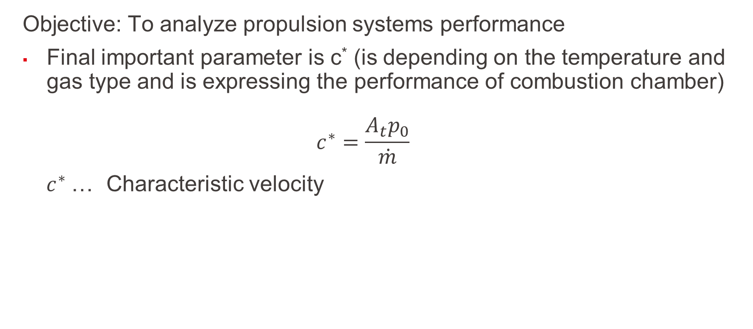
Which general Performance Equations are given?
Objective: To analyze propulsion systems performance
Final important parameter is c* (is depending on the temperature and gas type and is expressing the performance of combustion chamber) $c^{∗}=\frac{{A_{t}p}_{0}}{\dot{m}}$
$c^{∗}$… Characteristic velocity
L2 – Propulsion Systems
Space Propulsion ENG-510

Slide 84
Which general Performance Equations are given?
L2 – Propulsion Systems
Space Propulsion ENG-510

Slide 85
Which general Performance Equations are given?
Objective: To analyze propulsion systems performance
Nozzle layout considerations
L2 – Propulsion Systems
Space Propulsion ENG-510

Slide 86
Which general Performance Equations are given?
Objective: To analyze propulsion systems performance
Nozzle layout considerations
L2 – Propulsion Systems
Space Propulsion ENG-510

Slide 87
Which general Performance Equations are given?
Objective: To analyze propulsion systems performance
Nozzle layout considerations
L2 – Propulsion Systems
Space Propulsion ENG-510

Slide 88
Which general Performance Equations are given?
Objective: To analyze propulsion systems performance
Nozzle layout considerations
L2 – Propulsion Systems
Space Propulsion ENG-510

Slide 89
Which general Performance Equations are given?
Objective: To analyze propulsion systems performance
Test as you fly and fly as you test…
Example: Sea-level testing of large engines instead of altitude (vacuum) testing
L2 – Propulsion Systems
Space Propulsion ENG-510

Slide 90
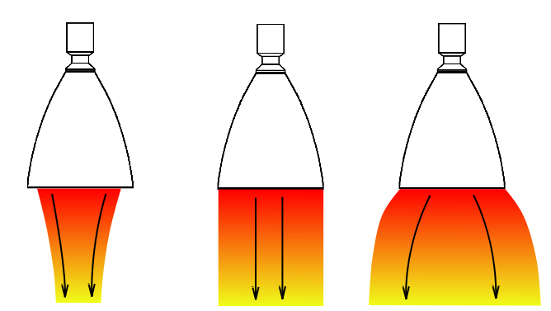
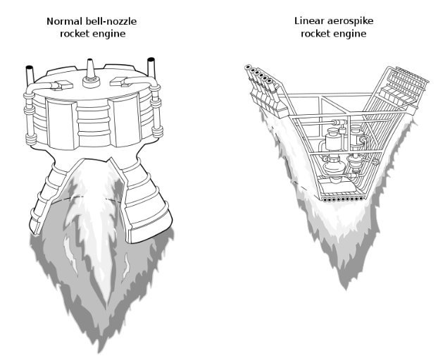
Which general Performance Equations are given?
Objective: To analyze propulsion systems performance
Bell-shaped nozzle extensions compared to aerospike engines
L2 – Propulsion Systems
Space Propulsion ENG-510

Slide 91
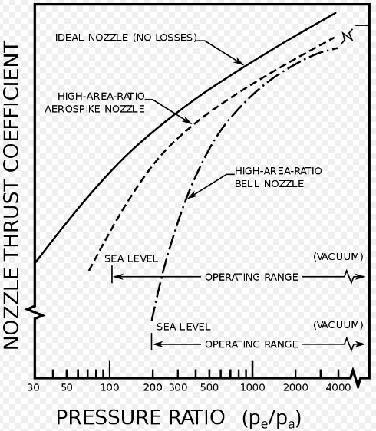
Which general Performance Equations are given?
Objective: To analyze propulsion systems performance
Aerospike engines allow:
Optimal performance over wider external pressure range (wider altitude range)
Spike and surrounding air flow form a virtual bell
Aerospike engines lead:
Increased thermal loads on spike
L2 – Propulsion Systems
Space Propulsion ENG-510

Slide 92
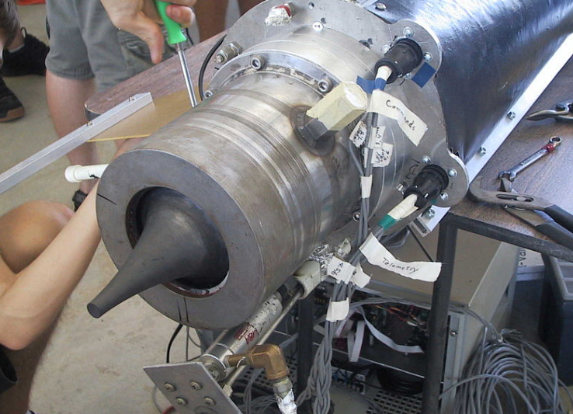
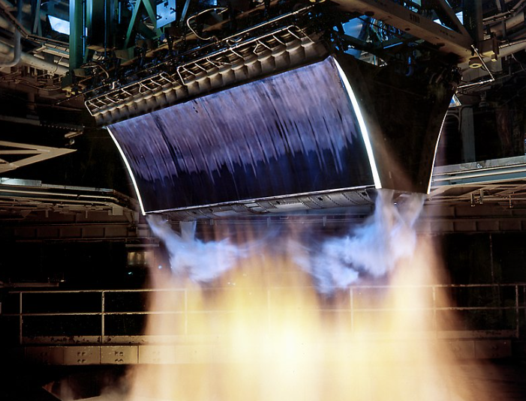
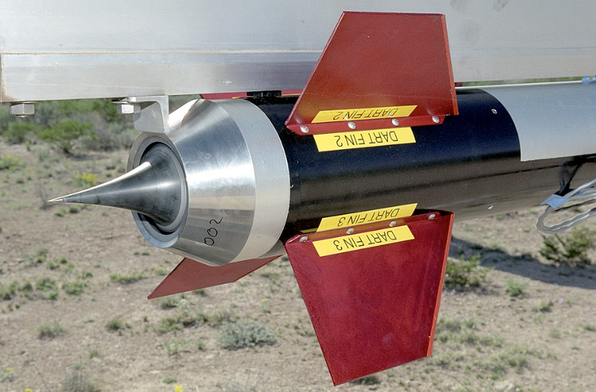
Which general Performance Equations are given?
Objective: To analyze propulsion systems performance
Aerospike engines exist as:
Toroidal aerospike
Linear aerospike
But no commercial application is given today
L2 – Propulsion Systems
Space Propulsion ENG-510

Slide 93
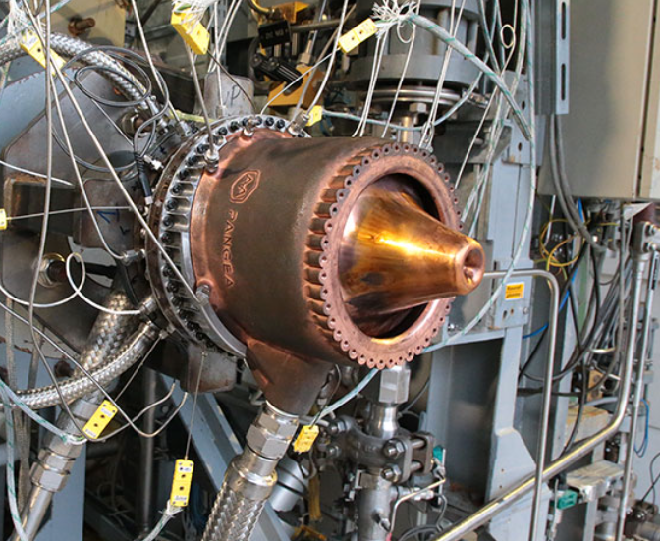




Which general Performance Equations are given?
L2 – Propulsion Systems
Space Propulsion ENG-510

Slide 94
Which Propulsion Systems do we know?
Objective: To categorize different space propulsion systems
Space propulsion / in-space propulsion / towards space propulsion - Everything that accelerates a vehicle (launcher, rocket, satellite, orbital vehicle) by ejection of material
L2 – Propulsion Systems
Space Propulsion ENG-510

Slide 95
Which Propulsion Systems do we know?
Objective: To categorize different space propulsion systems
Energy and Propellant:
Energy is needed to throw out the propellant / mass to get the push
Some energy must be converted to kinetic energy
A propulsion system is an energy converter / accelerator
L2 – Propulsion Systems
Space Propulsion ENG-510
Energy
Conversion / Acceleration
Impulse
Mass

Slide 96
Which Propulsion Systems do we know?
Objective: To categorize different space propulsion systems
Useable Energy:
Nuclear fusion
Nuclear fission
Chemical reaction
Pressure release
Electrical battery
Solar power
Muscle power
Mechanical acceleration
Others…
L2 – Propulsion Systems
Space Propulsion ENG-510

Slide 97
Which Propulsion Systems do we know?
Objective: To categorize different space propulsion systems
Transferring into space propulsion systems:
Nuclear fusion -> Not existing today
Nuclear fission -> Nuclear reactor is coming back again
Chemical reaction -> In use
Pressure release -> In use
Electrical battery -> In use
Solar power -> In use
Muscle power -> Not sufficient
Mechanical acceleration -> Under investigation (centrifuge)
Others… -> To be discussed
L2 – Propulsion Systems
Space Propulsion ENG-510

Slide 98
Which Propulsion Systems do we know?
Objective: To categorize different space propulsion systems
Energy type and propulsion systems:
Nuclear fusion -> Not applicable
Nuclear fission -> Nuclear thermal propulsion and nuclear electric propulsion
Chemical reaction -> Chemical propulsion
Pressure release -> Pneumatic propulsion
Electrical battery -> Electric propulsion
Solar power -> Solar (radiant) electric propulsion
Muscle power
Mechanical acceleration -> Mechanical propulsion
Others… -> To be discussed
L2 – Propulsion Systems
Space Propulsion ENG-510

Slide 99
Which Propulsion Systems do we know?
Objective: To categorize different space propulsion systems
Propulsion System categorization linked to energy conversion type:
Thermal Propulsion Systems (e.g. cold gas systems but also including electrothermal + solar thermal + nuclear thermal propulsion)
Chemical (Combustion) Propulsion Systems
Electrical Propulsion Systems (including nuclear electric propulsion)
Mechanical Propulsion Systems (e.g. gun, centrifuge, …)
Others…like radiant energy / solar wind / lasers
L2 – Propulsion Systems
Space Propulsion ENG-510

Slide 100
Which Propulsion Systems do we know?
Objective: To categorize different space propulsion systems
Comparison of different Propulsion Systems:
Thermal Propulsion Systems
Chemical (Combustion) Propulsion Systems
Electrical Propulsion Systems
Mechanical Propulsion Systems
Others…
Possible Performance as Function of Propulsion Technology
L2 – Propulsion Systems
Space Propulsion ENG-510
Cold Gas
Hydrazin
Prop Ratio (Prop Mass / Wet Mass) [-]
MON / MMH
HET
GIT
Δv [m / s]

Slide 101
Which Propulsion Systems do we know?
Objective: To categorize different space propulsion systems
Generic block diagram for propulsion systems:
L2 – Propulsion Systems
Propellant
Space Propulsion ENG-510
Propellant Storage
Propellant Feed System
Accelerator
Mass Ejection
Energy Source
Energy Conversion

Slide 102
Which Thermal Propulsion Systems exist?
Objective: To develop the basics of thermal propulsion
Thermal Propulsion Systems
Cold gas propulsion systems
Cold gas / liquid propulsion systems (e.g. Water rocket…)
Solid powder / cold gas propulsion systems
Cryogenic boil-off propulsion systems
Liquefied gas propulsion systems
Electrothermal propulsion systems
Solar thermal propulsion systems
Nuclear thermal propulsion systems
L2 – Propulsion Systems
Space Propulsion ENG-510

Slide 103
Which Thermal Propulsion Systems exist?
Objective: To develop the basics of thermal propulsion
Thermal Propulsion Systems – Group 1
Cold gas propulsion systems
Cold gas / liquid propulsion systems (e.g. Water rocket…)
Solid powder / cold gas propulsion systems
Cryogenic boil-off propulsion systems
Liquefied gas propulsion systems
L2 – Propulsion Systems
Space Propulsion ENG-510

Slide 104
Which Thermal Propulsion Systems exist?
Objective: To develop the basics of thermal propulsion
Thermal Propulsion Systems – Group 2
Electrothermal propulsion systems
Thermal Propulsion Systems – Group 3
Solar thermal propulsion systems
Nuclear thermal propulsion systems
L2 – Propulsion Systems
Space Propulsion ENG-510

Slide 105
Which Thermal Propulsion Systems exist?
Objective: To develop the basics of thermal propulsion – Group 1
Application
Small Δv missions (e.g. only attitude control)
Small spacecrafts (e.g. cubesats)
Architecture
Blow-down systems
L2 – Propulsion Systems
Space Propulsion ENG-510

Slide 106
Which Thermal Propulsion Systems exist?
Propellant Phase in Tanks
Solid
Liquid
Gas
Objective: To develop the basics of thermal propulsion – Group 1
1
B
Combustion
L2 – Propulsion Systems
Space Propulsion ENG-510
Chemical Reaction
Decomp
Cold Gas Propulsion System / Thruster
No
Powder
Liquified Gas Gas (Xe, N2, Ar)

Slide 107
Which Thermal Propulsion Systems exist?
Objective: To develop the basics of thermal propulsion – Group 1
Block diagram for Thermal Cold Gas Propulsion Systems:
L2 – Propulsion Systems
Propellant (Gas)
Space Propulsion ENG-510
Propellant Storage (Pressure Tank)
Propellant Feed System
Accelerator (Nozzle Extension)
Mass (Gas) Ejection
Energy Source
(Compressed Gas)
Conversion
(De-pressurization)

Slide 108
Which Thermal Propulsion Systems exist?
Objective: To develop the basics of thermal propulsion – Group 1
Characteristics of Thermal Cold Gas Propulsion Systems:
High degree of reliability
Low system complexity (no combustion involved)
Low Δv
Extremely safe operation
No contamination from exhaust (combustion) gases
Low thrust
High pressure on ground
L2 – Propulsion Systems
Space Propulsion ENG-510

Slide 109
Which Thermal Propulsion Systems exist?
Objective: To develop the basics of thermal propulsion – Group 1
Architecture of Thermal Cold Gas Propulsion Systems (as a cold gas reaction control system):
L2 – Propulsion Systems
Space Propulsion ENG-510
Tank
Exhaust
Regulator
Valve
R

Slide 110
Which Thermal Propulsion Systems exist?
Objective: To develop the basics of thermal propulsion – Group 1
Architecture of Thermal Cold Gas Propulsion Systems:
Consideration of a pressure regulator is not mandatory, but
It allows to operate all Equipment below the regulator at lower pressure and therefore has lower strength requirements
It allows to operate the thruster at constant inlet pressure until the storage tank pressure drops below the regulator pressure and therefore ensures consistent level of thrust
L2 – Propulsion Systems
Space Propulsion ENG-510

Slide 111
Which Thermal Propulsion Systems exist?
Objective: To develop the basics of thermal propulsion – Group 1
Thermal Cold Gas propulsion characteristics (needed propellant mass @ T = 298 K for different gases with same Δv requirement)
L2 – Propulsion Systems
Gas | a₀ [m/s] | C* [m/s] | m [kg/s] | Isp [s] | M [kg]
Air | 346.1 | 427.2 | 0.051 | 78.9 | 51.6
Argon | 320.7 | 343.6 | 0.071 | 57.0 | 71.5
CO2 | 269.3 | 356.8 | 0.056 | 72.3 | 56.3
He | 1013.8 | 1085.6 | 0.022 | 180.1 | 22.6
H2 | 1314.4 | 1617.4 | 0.013 | 297.8 | 13.7
N2 | 351.9 | 434.4 | 0.050 | 80.2 | 50.8
O2 | 328.7 | 406.9 | 0.054 | 75.4 | 54.0
Space Propulsion ENG-510

Slide 112



Which Thermal Propulsion Systems exist?
Objective: To develop the basics of thermal propulsion – Group 1
Example: Cold Gas propulsion system
L2 – Propulsion Systems
Space Propulsion ENG-510

Slide 113



Which Thermal Propulsion Systems exist?
Objective: To develop the basics of thermal propulsion – Group 1
Example: Cube Sat propulsion system
General specification:
Four 1mN thrusters with closed loop thrust control
Thrust resolution: <10µN
Propellant: Butane
Total impulse: 40Ns
Size: 10*10*3cm
Mass: 250g
Operating pressure: 2-5 bar
Power consumption: 2 W
L2 – Propulsion Systems
Space Propulsion ENG-510

Slide 114

Which Thermal Propulsion Systems exist?
Objective: To develop the basics of thermal propulsion – Group 1
Basic performance equations:
Sonic velocity $a_{0}=\sqrt{γRT_{0}}$
Characteristic velocity $c^{∗}=\frac{a_{0}}{{γ(\frac{2}{γ+1})}^{\frac{y+1}{2γ−2}}}$
L2 – Propulsion Systems
Space Propulsion ENG-510

Slide 115

Which Thermal Propulsion Systems exist?
Objective: To develop the basics of thermal propulsion – Group 1
Basic performance equations:
Thrust $F=A_{t}p_{C}γ\sqrt{ (\frac{2}{γ−1}){(\frac{2}{γ+1}\text{)}}^{\left(\frac{γ+1}{γ−1}\right)}(1−{\left(\frac{p_{e}}{p_{c}}\right)}^{\frac{γ−1}{γ}})}+(p_{e}−p_{a})A_{e}$
Mass flow $\dot{m}=\frac{A_{t}p_{C}}{c^{∗}}$
L2 – Propulsion Systems
Space Propulsion ENG-510

Slide 116

Which Thermal Propulsion Systems exist?
Objective: To develop the basics of thermal propulsion – Group 1
Basic performance equations:
Isp $I_{sp}=\frac{F}{{\dot{m}g}_{0}}$
L2 – Propulsion Systems
Space Propulsion ENG-510

Slide 117
Which Thermal Propulsion Systems exist?
Objective: To develop the basics of thermal propulsion – Group 1
Architecture of Thermal Cold Gas / Liquid Propulsion Systems (as student project):
L2 – Propulsion Systems
Space Propulsion ENG-510
Gas phase
Tank
Liquid phase
Exhaust
Valve

Slide 118



Which Thermal Propulsion Systems exist?
Objective: To develop the basics of thermal propulsion – Group 1
Example: Plasti Blast and others
L2 – Propulsion Systems
Space Propulsion ENG-510

Slide 119
Which Thermal Propulsion Systems exist?
Objective: To develop the basics of thermal propulsion – Group 1
Architecture of Thermal Gas Propulsion Systems solid powder on ground for storage:
L2 – Propulsion Systems
Space Propulsion ENG-510
Ignitor
Tank
Exhaust
Regulator
Valve
Powder Tank
R

Slide 120
Which Thermal Propulsion Systems exist?
Objective: To develop the basics of thermal propulsion – Group 1
Characteristics of Thermal Gas Propulsion Systems:
High degree of reliability
Medium low system complexity (no combustion involved)
Low Δv
Extremely safe operation
No contamination from exhaust (combustion) gases
Low thrust
High pressure on ground
L2 – Propulsion Systems
Space Propulsion ENG-510

Slide 121
Which Thermal Propulsion Systems exist?
Objective: To develop the basics of thermal propulsion – Group 1
Architecture of Cryogenic Boil-off:
L2 – Propulsion Systems
Space Propulsion ENG-510
Exhaust
Valve
Tank

Slide 122
Which Thermal Propulsion Systems exist?
Objective: To develop the basics of thermal propulsion – Group 1
Example: LH2 boil-off in cryogenic upper stages
Permanent LH2 boil-off is given as propellant temperature is @ 20 K
Tank pressure is important parameter to control liquid temperature
Also de-pressurization is performed to cool-down the propellant
Available gas pressure can be used for propellant settling, as attitude control system…but might also be just vented (not providing any impulse to the upper stage)
No pressure regulator is needed as tank pressure is already very low
L2 – Propulsion Systems
Space Propulsion ENG-510

Slide 123


Which Thermal Propulsion Systems exist?
Objective: To develop the basics of thermal propulsion – Group 1
Example: A5ME / A6 launch vehicles and TEC Nyx Moon capsule
L2 – Propulsion Systems
Space Propulsion ENG-510

Slide 124
Which Thermal Propulsion Systems exist?
Objective: To develop the basics of thermal propulsion – Group 1
Architecture of Storable Propellant Boil-off @ ambient temperatures considering high vapor pressures:
L2 – Propulsion Systems
Space Propulsion ENG-510
Exhaust
Valve
Tank
Heater

Slide 125
Which Thermal Propulsion Systems exist?
Objective: To develop the basics of thermal propulsion – Group 1
Example: N2O boil-off in
Forced N2O boil-off due to high vapor pressure and correlation between liquid temperature and gas pressure
is important parameter to control liquid temperature
But also other way round liquid temperature is important parameter to control tank pressure
Available gas pressure can be used for propellant settling, as attitude control system…but might also be just vented (not providing any impulse to the upper stage)
Pressure regulator might be needed in order to get constant thrust (but could also controlled by effective temperature control of liquid N2O)
L2 – Propulsion Systems
Space Propulsion ENG-510

Slide 126
Which Thermal Propulsion Systems exist?
Objective: To develop the basics of thermal propulsion – Group 1
Block diagram for Thermal Liquefied Gas Propulsion Systems:
L2 – Propulsion Systems
Propellant (Liquefied Gas)
Space Propulsion ENG-510
Propellant Storage (Liquid Tank)
Propellant Feed System
Accelerator (Nozzle Extension)
Mass (Gas) Ejection
Energy Source
(Heat Exchanger)
Conversion
(Vaporization)

Slide 127
Which Thermal Propulsion Systems exist?
Objective: To develop the basics of thermal propulsion – Group 1
Architecture of Thermal Liquefied Gas Propulsion Systems (as a cold gas reaction control system):
L2 – Propulsion Systems
LOx
LHe
Space Propulsion ENG-510
Tank with liquefied gas @ cryogenic temperature
Exhaust
Valve
Pump
Tank with cryogenic propellant
P
Heat Exchanger

Slide 128
Which Thermal Propulsion Systems exist?
Objective: To develop the basics of thermal propulsion – Group 1
Architecture of Thermal Liquefied Gas Propulsion Systems:
Means must be provided for storage of liquefied gas (e.g. by storage of gas inside cryogenic propellant tank)
Heat Exchanger must be used in order to ensure sufficient vaporization rate
Most probably pump is needed to increased pressure of vaporized gas @ thruster (nozzle extension) inlet
L2 – Propulsion Systems
Space Propulsion ENG-510

Slide 129
Which Thermal Propulsion Systems exist?
Objective: To develop the basics of thermal propulsion – Group 1
Characteristics of Thermal Liquefied Gas Propulsion Systems:
High degree of reliability
High system complexity (no combustion involved but storage of liquefied gas)
Low Δv
Extremely safe operation
No contamination from exhaust (combustion) gases
Low thrust
Additional equipment (Heat Exchanger and potentially pump)
Gas tank in liquid tank
L2 – Propulsion Systems
Space Propulsion ENG-510

Slide 130

Which Thermal Propulsion Systems exist?
Objective: To develop the basics of thermal propulsion – Group 1
Example: SSHEL of ARIANE 5
L2 – Propulsion Systems
Space Propulsion ENG-510

Slide 131
Which Thermal Propulsion Systems exist?
Objective: To develop the basics of thermal propulsion – Group 1
Performance comparison of different pneumatical propulsion systems
 | Cold Gas | Solid Powder | Cryogenic Boil-off | Liquefied Gas | Water Rocket
Medium | GN2 | GN2 | GH2 | GHe | Air
Temperature | 293 K | 1300 K | 20 K | 4 K up | 293 K
Use case | Cubesat propulsion Attitude control | Pressurant gas De-orbit burn | Attitude control | Attitude control Pressurant gas | Fun
L2 – Propulsion Systems
Space Propulsion ENG-510

